Slide 1

Corpus Research for Writing Development
Phil Durrant

Slide 2
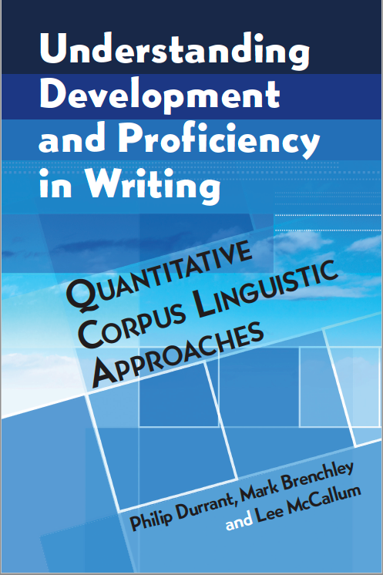




Mark Brenchley
Cambridge Assessment English
Lee McCallum
University of Exeter
Debra Myhill
University of Exeter

Slide 3
Letters at Years 2 and 11 in England
Dear queen
I am writing to you about the indanderd serious sea turtles. They are bieng hunted and killed for there shells. There shells ceep them safe.
People thow litter in the sea and somtimes if there is some plastic and they don’t know what it is they mite eat it a dadly.
Fisher’s catch sea turtles and they get stuck in a net also if they get out they will be dameged.
Dear Sir,
I am writing to express my views on the article you recently printed, detailing a scheme by the Divert trust to help difficult students.
At first I was unsure if this scheme could ever work, and was indignant, like so many others, that many good students remained unrewarded. However, after researching this scheme I have come to realise that it is rather a brilliant idea. Research shows that around 88% of schools admit to not being able to cope with difficult students.
Growth in Grammar Corpus

Slide 4
L2 letters at CEFR bands B1 & C2
Dear Pat, How are you? It’s a long time since we don’t write. well first of all, thanks for the congratulations, it was really difficult won this price becouse there were too much projects interesting. well I won the first price because I did a machine that using the energy of the sun giveelectricity to my house, it was a nice project. what’s about that organization? how can I help staying here? Can you explain me all in your next letter?
Dear editor, This letter is written in response to the comments published in the local newspaper concerning the intention of authorities of creating modern buildings in the city centre. I would like to comment on the points raised and also give my personal opinion. To begin with, I couldn’t agree more with the comment claiming that modern buildings should be built in accordance with older ones so that they fit in with them. Our city, well-known for its beauty and harmony in structure needs to remain that way
Cambridge Learner Corpus

Slide 5
Why study development in written language?
Explicit linguistic descriptions of differences across time and quality can give important educational insights…

Slide 6
Why study writing development?
Evaluate the outcomes of programmes/interventions
Evaluate expectations for educational stages
Identify learners/groups who need additional help
  Specify areas in which they need that help
Understand what gets counts as ‘good writing’

Slide 7
Why study writing development?
Understand linguistic demands of education and how those demands vary across levels of study and academic disciplines
Understand children’s social and cognitive development: i.e. their capacity to construe thought and experience through writing in an increasingly sophisticated range of topic areas and written genres

Slide 8
What is a quantitative corpus linguistic (QCL) approach to studying writing development?
Compiles (often authentic) samples of learner writing which vary along the axes of time and/or quality.
Stores these samples in electronic form.
Conducts quantitative analysis of the language used in these samples to detect developmental patterns (usually in terms of frequency/length of features).
(Preferably) investigates texts qualitatively to understand the meaning/reason underlying any developmental patterns.

Slide 9
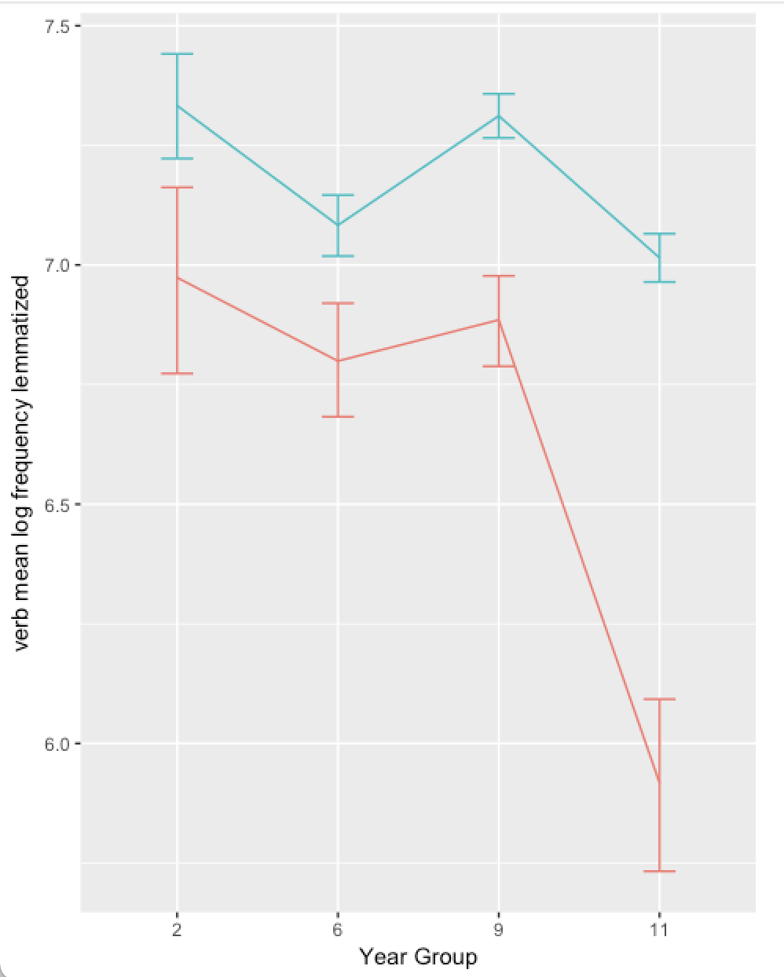
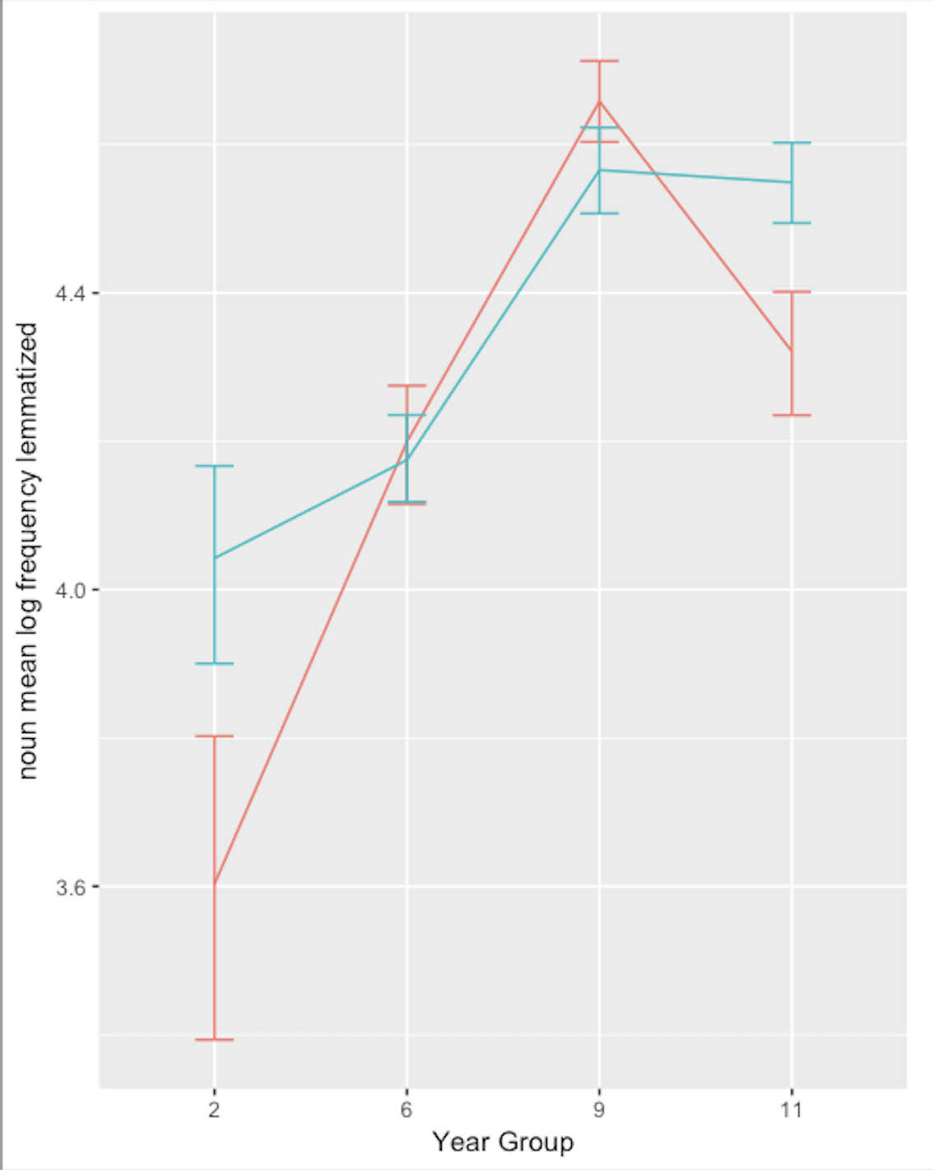
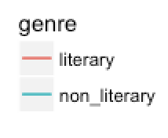
For example: vocabulary frequencies
Verb frequencies over time
Noun frequencies over time

Slide 10
Typical Year 2 use of nouns (literary)
One day on a stormy, wet, cold, morning Rosie saw her first red fairy. She looked up and saw a magical fairy. She let the red fairy in the house. After playtime the more Rosie looked the more book fairies she saw in the sky but no one else noticed them. Rosie went into the Institutionname class room and in the trays she found a map to fairyland.

Slide 11
Typical Year 2 use of nouns (non-literary)
Long ago in 1605 there was a mean King called King James I and there was a very sneaky man called Guy. There was other plotters. Robert Catesby was the leader of the plotters. Then Guy Fawkes went into the cellar of the Houses of Parliament and also put 36 barrels of gunpowder. Next Guy Fawkes hided behind the 36 barrels of gunpowder. Suddenly Lord Monteagle received a letter and said there’s man who’s trying to blow up the king. You must burn this letter. King James I called his soldiers to find that sneaky man and they found Guy Fawkes in the cellar. So they then executed them pulled Guy Fawkes’ head that couldn’t move. His was on a spike.

Slide 12
Why take a QCL approach?
Large samples:
  Generalizability
  Variation across contexts
  Emergence of surprising patterns.
Contextually authentic
Explicit operationalization of linguistic constructs:
  Transparent
  Specific findings

Slide 13
Generalizability

Slide 14
Some potential issues
Are there regular patterns of linguistic variation that hold across individuals and contexts?
Do any such generalizations give educationally useful information?

Slide 15
Reviewing the literature: 1945-2015/18
 | Syntax | Vocabulary | Cohesion | Formulaic language
First language | 66 | 45 | 19 | 0
Second language | 79 | 69 | 18 | 28

Slide 16
L1 TIME Syntax: Generic indices; NP length (esp. relative clauses; PP postmod.); Passives Adv. clauses? | L2 TIME
L1 QUALITY | L2 QUALITY Syntax: Generic indices; NP length (esp. relative clauses; PP postmod); Passives Adv. clauses?

Slide 17
L1 TIME Syntax: Generic indices; NP length (esp. relative clauses; PP postmod.); Passives Adv. clauses? | L2 TIME Syntax: Generic index: clause density; NP length Adv. clauses?
L1 QUALITY Syntax: Generic index: mean T-unit length; NP length? | L2 QUALITY Syntax: Generic indices; NP length (esp. relative clauses; PP postmod); Passives Adv. clauses?

Slide 18
L1 TIME Syntax: Generic indices; NP length (esp. relative clauses; PP postmod.); Passives Adv. clauses? Vocabulary: Diversity; Academic words | L2 TIME Syntax: Generic index: clause density; NP length Adv. clauses?
L1 QUALITY Syntax: Generic index: mean T-unit length; NP length? | L2 QUALITY Syntax: Generic indices; NP length (esp. relative clauses; PP postmod); Passives Adv. clauses? Vocabulary: Diversity; Academic words

Slide 19
L1 TIME Syntax: Generic indices; NP length (esp. relative clauses; PP postmod.); Passives Adv. clauses? Vocabulary: Diversity; Academic words | L2 TIME Syntax: Generic index: clause density; NP length Adv. clauses? Vocabulary: Diversity?
L1 QUALITY Syntax: Generic index: mean T-unit length; NP length? Vocabulary: Diversity; infrequent words | L2 QUALITY Syntax: Generic indices; NP length (esp. relative clauses; PP postmod); Passives Adv. clauses? Vocabulary: Diversity; Academic words

Slide 20
L1 TIME Syntax: Generic indices; NP length (esp. relative clauses; PP postmod.); Passives Adv. clauses? Vocabulary: Diversity; Academic words Cohesion X | L2 TIME Syntax: Generic index: clause density; NP length Adv. clauses? Vocabulary: Diversity? Cohesion X
L1 QUALITY Syntax: Generic index: mean T-unit length; NP length? Vocabulary: Diversity; infrequent words Cohesion: X | L2 QUALITY Syntax: Generic indices; NP length (esp. relative clauses; PP postmod); Passives Adv. clauses? Vocabulary: Diversity; Academic words Cohesion X

Slide 21
L1 TIME Syntax: Generic indices; NP length (esp. relative clauses; PP postmod.); Passives Adv. clauses? Vocabulary: Diversity; Academic words Cohesion X | L2 TIME Syntax: Generic index: clause density; NP length Adv. clauses? Vocabulary: Diversity? Cohesion X
L1 QUALITY Syntax: Generic index: mean T-unit length; NP length? Vocabulary: Diversity; infrequent words Cohesion: X | L2 QUALITY Syntax: Generic indices; NP length (esp. relative clauses; PP postmod); Passives Adv. clauses? Vocabulary: Diversity; Academic words Cohesion X Formulaic language Association measures (MI); attested ngrams

Slide 22
Are there broad generalizations to make?
A small number of measures are consistent across contexts for L1 time and L2 quality.
Fewer reliable patterns for L1 quality and L2 time.
Overall, evidence is sparse and features are inconsistently defined.

Slide 23
For details
http://phildurrant.net/quantitative-measures-of-written-language-use/

Slide 24
Are generalizations educationally useful?
The case of generic indices.
One broad syntactic category divided by another, e.g.:
  Words per clause
  Clauses per T-unit (clause density)
  Words per T-unit
  T-units per sentence
  Words per sentence
Review identifies 149 L1 counts; 225 L2 counts
Objective; easy to score; reliably correlated with development

Slide 25
But…
‘Hidden’ differences in definitions of clause and T-unit.
Minimal information about development. E.g.:
  No distinction between clause types.
  For words per X measures: no distinction between phrasal and clausal complexity.
Unclear theoretical interpretation (complexity? fluency?)
In short: A ‘vague’ level of description…

Slide 26
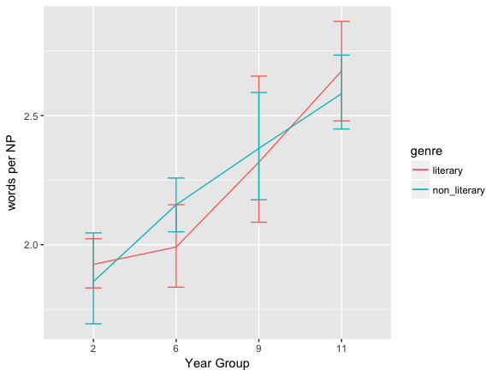
Words per Noun Phrase

Slide 27
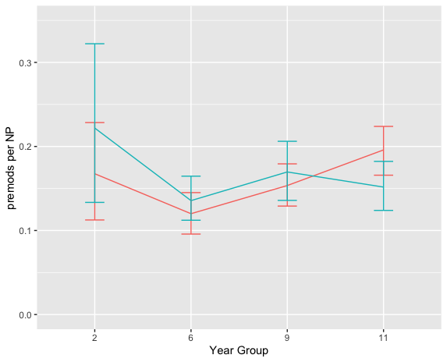
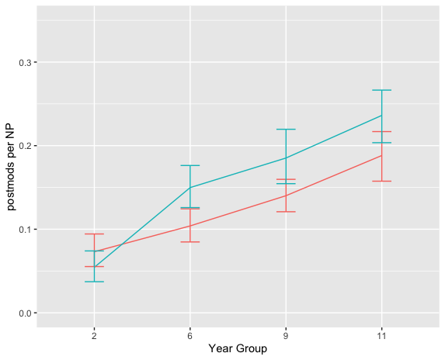
Types of modification
Premodifiers per noun phrase
Postmodifiers per noun phrase

Slide 28
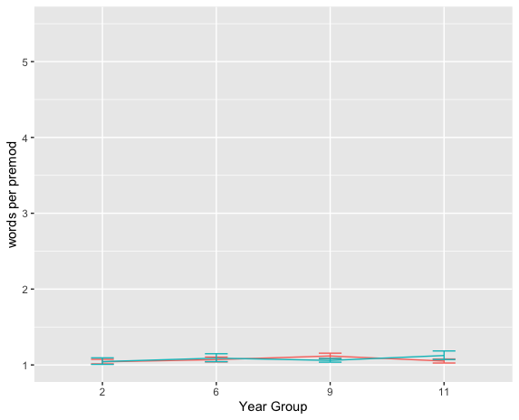
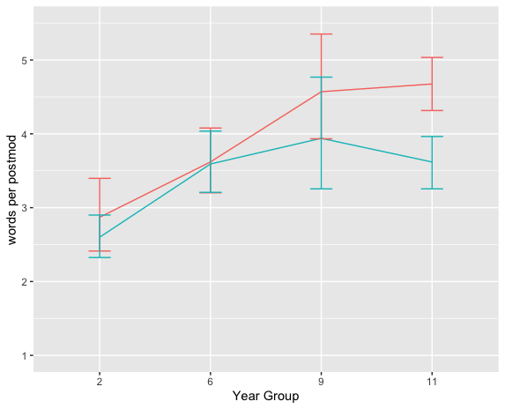
Types of modification
Words per premodifier
Words per postmodifier

Slide 29
Generic measures of syntax hide these patterns and are less educationally informative.

Slide 30
Authenticity

Slide 31
QCL is observational & authentic
QCL captures contextualized language in use.
Can be educationally authentic: i.e. texts are written as part of learners’ regular educational life, rather than elicited for research purposes.

Slide 32

Writing proficiency as contextual

Slide 33
Writing proficiency as contextual
sunshine
café music
comfortable chair/table
word processor
internet connection
coffee
telephone

Slide 34
Writing proficiency as contextual
research article genre
English language
strong motivation
deadlines
corpus linguistics topic
research audience

Slide 35
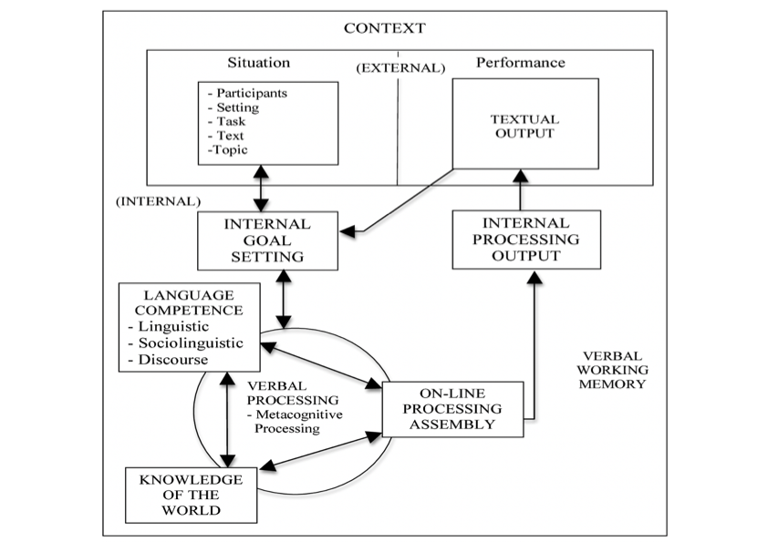
Writing proficiency as a complex construct
Grabe & Kaplan 1996

Slide 36
Writing proficiency as a complex construct
QCL
Grabe & Kaplan 1996

Slide 37
So…
Corpus contains outputs from a complex and contextualized process.
This makes them authentic and contextually valid.
BUT: inferences to individual proficiency or to linguistic constructs are problematic.
For example…

Slide 38
Teacher influence
Should Sbungab lifundur The see? We have been discussing whether Sbanchbab should lif under the sea.
Many people believe that Sbonchbab should live undur the sea because fersly Sbonbob can sacup the sea and secle Sbanbab can clen the racs. on the uver hand many dat blef that Sbongbab should not live under the sea because he isent a fish and he lifs in a haus and lifs bsid the sea.
in conclusion there are many great reasons for and against wefer Sbongbob should lif under The sea. but I blef that Sbongbob should lif under the sea because thas wer hes home is.

Slide 39
Teacher influence
Should Sbungab lifundur The see? We have been discussing whether Sbanchbab should lif under the sea.
Many people believe that Sbonchbab should live undur the sea because fersly Sbonbob can sacup the sea and secle Sbanbab can clen the racs. on the uver hand many dat blef that Sbongbab should not live under the sea because he isent a fish and he lifs in a haus and lifs bsid the sea.
in conclusion there are many great reasons for and against wefer Sbongbob should lif under The sea. but I blef that Sbongbob should lif under the sea because thas wer hes home is.

Slide 40
Teacher influence
Should the Spangebob liv ande de si? We have been discussting whetheer Spongbob should live under the sea.
Many people believe that Spongbok should live ander the see, bicase firstly he soaks up water. Secenly hi wash the rocs in the see. On the adh meni pepo beliv he shut not liv in the see bicoss hi is not e fihs.
In conclusion there are many great reasons for and against for spong bov should liv andr the see bicos deris hi hous.
Wat do uia finc?

Slide 41
Teacher influence
Should school bi open 5 days a week?
We have ben discussing Whether school should be open 5 days a week?
Many people belive that school should be open 5 days a week because firstly, we learn more in the closs rum. Secandly, we get to see our friends more. On the adhand mani people beliv school shouldn't be open 5 deys a week. the cis want mor taym to play withe toys.

Slide 42
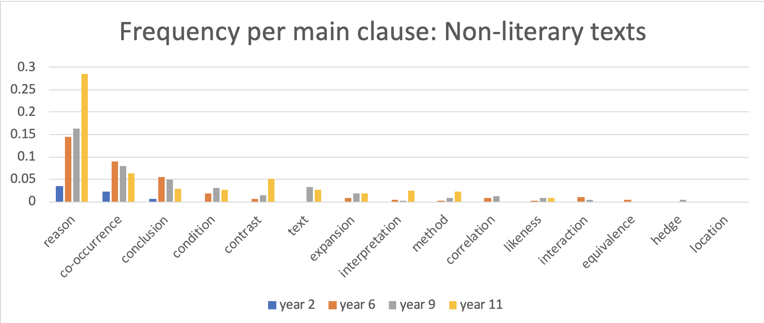
Task influence: Adverbial clause frequency

Slide 43
Task influence: Adverbial clause frequency
What explains this jump?

Slide 44
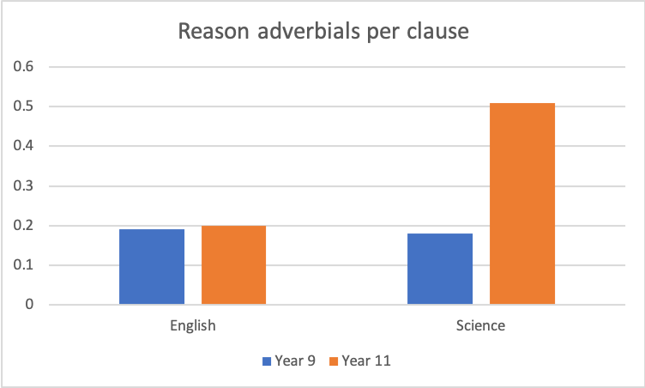
More specifically

Slide 45
Science Writing Tasks
Typical Year 9 tasks
Describe how Thashan is investigating the strength of electromagnets
A report on an investigation into the properties of bouncing balls
Typical Year 11 tasks
Look at the energy flow through the food chain…Explain how energy is lost from this food chain and why this limits the length of the food chain
Describe the similarities and differences between Graph A and Graph B and suggest reasons for these differences

Slide 46
So…
Writing often strongly influenced by teacher input
Differing text types/topics/performance conditions across age groups
Corpus data show proficiency in context
  we learn simultaneously about development in learners and development of contexts, and these often cannot be separated.

Slide 47
Conclusions
Quantitative corpus linguistic methods have strong potential to inform our understanding of writing development in pedagogically useful ways.
BUT:
  We need to be careful in our choice of linguistic constructs:
    Consistent and explicit operationalization & theorization
    Pedagogically informative: tension between specificity and generalizability
  We need to be careful in our inferences:
    Authenticity as both strength and limitation

Slide 48
Thank you…
p.l.durrant@exeter.ac.uk
https://twitter.com/p_durrant
http://phildurrant.net/

