Slide 1
Tracing development in academic language with a corpus
Phil Durrant

Slide 2

Year 2 History
Long Long ago in 1605 they was a mean man ckood Guy Fawkes. he wanted to kill the king ckood King James I he was mean becuase he said no catholics ulowd. Guy Fawkes nyoo how to ues gumpowder he ueds it to Ploa up the king.

Slide 3
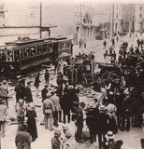
Year 9 History (excerpt)
I do believe that the Assassination of Franz Ferdinand was a major catalyst for the First World War as tension was already high as alliances were formed.
The assassination of Franz Ferdinand was a planned event executed by the Black Hand Gang which consisted of 7 conspirators: Apis, Gavrilo Pricip, two boys and three more. Apis was the leader of the group but it was Gavrilo who fired the fatal shots…
The Assassination of Franz Ferdinand is not the only cause of WW1 but it is one of the most famous, making people lean towards believing it to be the main cause. I believe it to be one of the main causes as, despite all the ridiculous coincidences, it shook the World.
This Photo by Unknown Author is licensed under CC BY-SA

Slide 4

Academic language as gatekeeper
The ability to use the specialized language of the academic sphere is like a gatekeeper: it opens doors for those who have it, and fastens them shut for those who do not.
Stanford teacher education program, cited in Rivera, 2007

Slide 5
So what can corpus linguists do?

Slide 6
1. Create explicit knowledge of
linguistic challenges
linguistic opportunities
offered by particular educational contexts / situations

Slide 7
So that we can…
develop strategies for dealing with challenges…
…and for maximizing learning opportunities.
And critique expectations.

Slide 8
2. Show the big picture…
how language demands differ / overlap across subject areas,
and educational levels.

Slide 9
So that we can…
make links across the curriculum
…and with past and future learning.

Slide 10
3. Create explicit knowledge of…
what development across year groups involves
what is valued in assessments

Slide 11
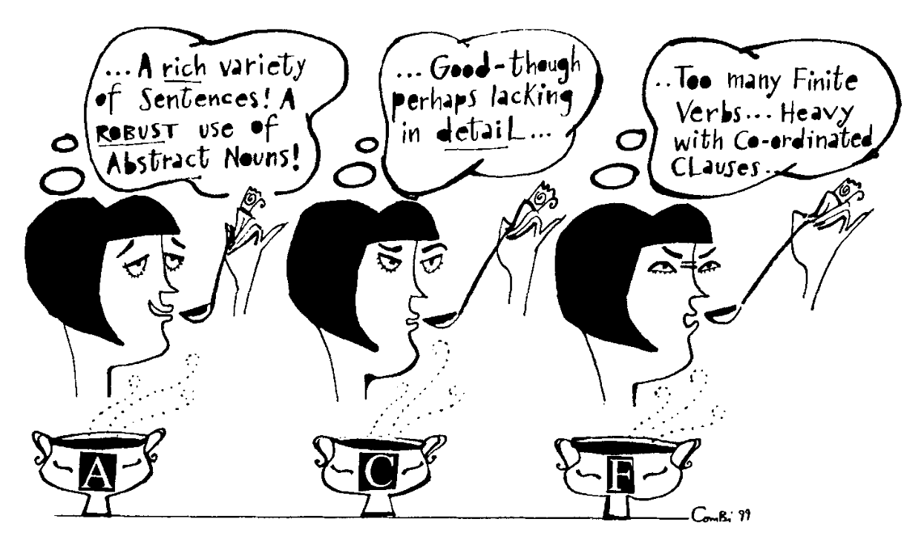
Myhill, 1999

Slide 12
So that we can…
promote fair, transparent, assessment
understand/evaluate/compare outcomes

Slide 13
And we should be curious about…
how the socio-epistemic structures of education shape language use;
what language use tells us about those educational structures;
how students learn to express complex, abstract ideas, take a stance, argue for a point, and establish relationships with imagined readers

Slide 14
All of this requires…

Slide 15
Understanding variation in language use across

Slide 16
Understanding variation in language use across
Levels of study
Subject areas
Task types
Levels of achievement

Slide 17
Levels of study
Subject areas
Task types
Levels of achievement
Educational Contexts
Learner groups
etc...
Also…

Slide 18
A worked example:
Noun Phrase complexity

Slide 19
A key feature of academic writing

Slide 20
A key feature of academic writing
In studying his continuous transformation groups (groups whose elements depend upon a system of continuously varying parameters satisfying certain differentiability conditions), Lie was led naturally to study some non-commutative, non-associative algebras subsequently named after him: Lie Algebras.
Biber et al. (2021), p.573

Slide 21
A key feature of academic writing
A: Trouble is granny does it and she’s got loads of time. She sits there and does them twice as fast as me. I – what I like doing, I like the pictures.
B: Yes.
A: So I don’t mind doing the pictures. If she’d do the sleeves and the back for me, I’d be very grateful.
B: Yeah.
A: Whereas she can’t stand doing the pictures, cos it takes her too much time.
B: It’s like doing tapestry.
Biber et al. (2021), p.573

Slide 22
In learner texts…

Slide 23
Year 2 History
Long Long ago in 1605 they was a mean man ckood Guy Fawkes. he wanted to kill the king ckood King James I he was mean becuase he said no catholics ulowd. Guy Fawkes nyoo how to ues gumpowder he ueds it to Ploa up the king.

Slide 24
Year 9 History (excerpt)
I do believe that the Assassination of Franz Ferdinand was a major catalyst for the First World War as tension was already high as alliances were formed.
The assassination of Franz Ferdinand was a planned event executed by the Black Hand Gang which consisted of 7 conspirators: Apis, Gavrilo Pricip, two boys and three more. Apis was the leader of the group but it was Gavrilo who fired the fatal shots…
The Assassination of Franz Ferdinand is not the only cause of WW1 but it is one of the most famous, making people lean towards believing it to be the main cause. I believe it to be one of the main causes as, despite all the ridiculous coincidences, it shook the World.

Slide 25
Year 9 History (excerpt)
I do believe that the Assassination of Franz Ferdinand was a major catalyst for the First World War as tension was already high as alliances were formed.
The assassination of Franz Ferdinand was a planned event executed by the Black Hand Gang which consisted of 7 conspirators: Apis, Gavrilo Pricip, two boys and three more. Apis was the leader of the group but it was Gavrilo who fired the fatal shots…
The Assassination of Franz Ferdinand is not the only cause of WW1 but it is one of the most famous, making people lean towards believing it to be the main cause. I believe it to be one of the main causes as, despite all the ridiculous coincidences, it shook the World.

Slide 26
we can generalize this…

Slide 27
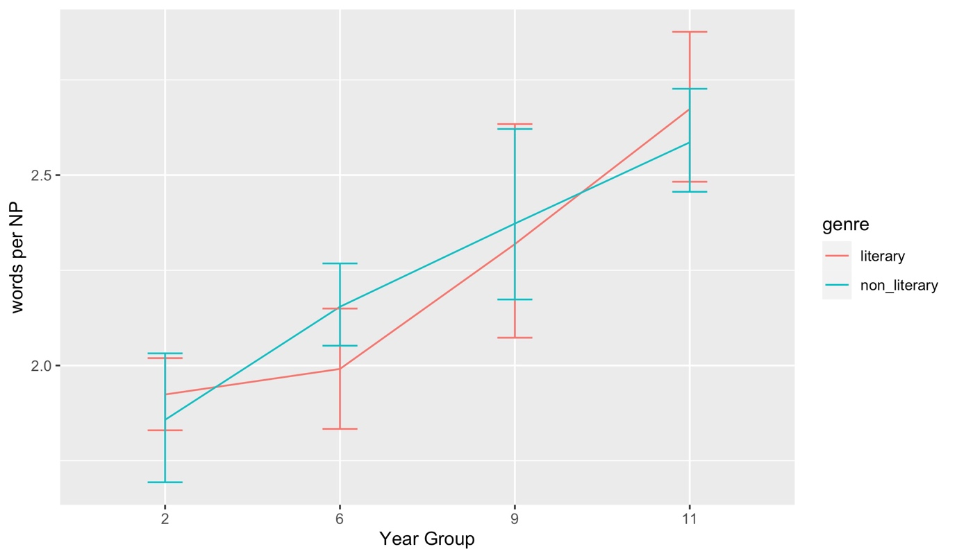
240 texts from GiG corpus (Durrant & Brenchley, 2023)

Slide 28
more specifically…

Slide 29
Key sites of development:
Frequency of prepositional phrases
the Assassination | of Franz Ferdinand
a major catalyst | for the First World War
the leader | of the group
the only cause | of WW1

Slide 30
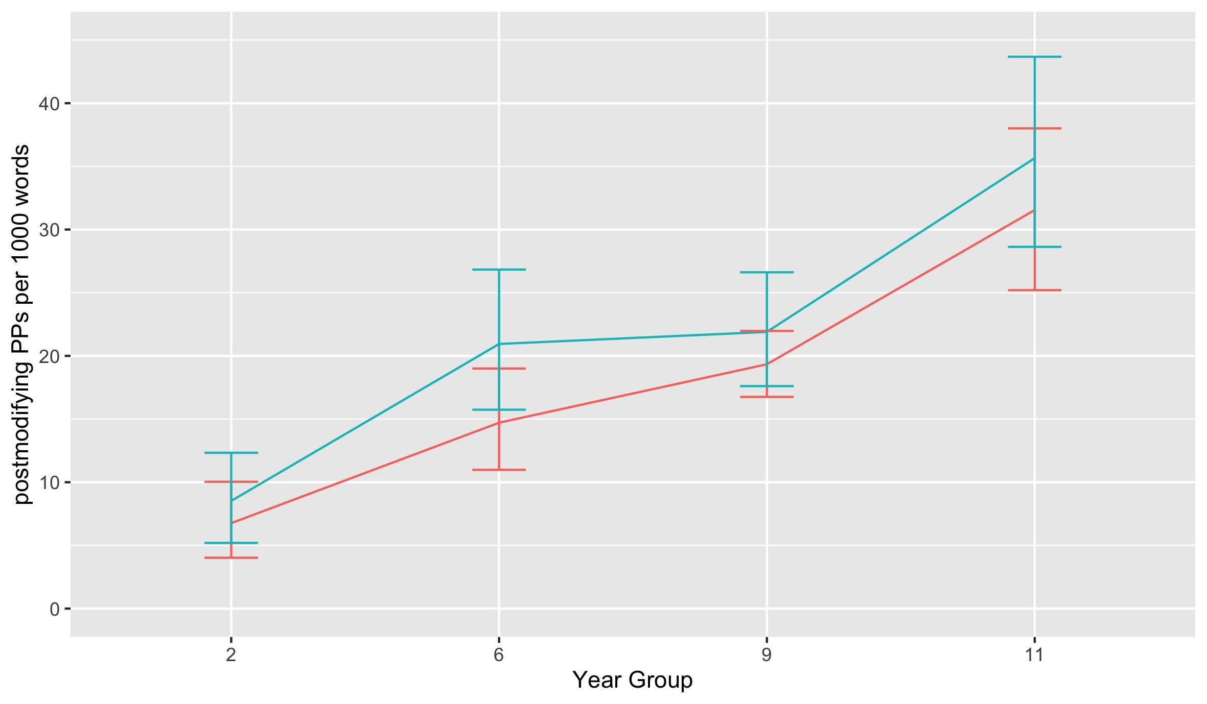
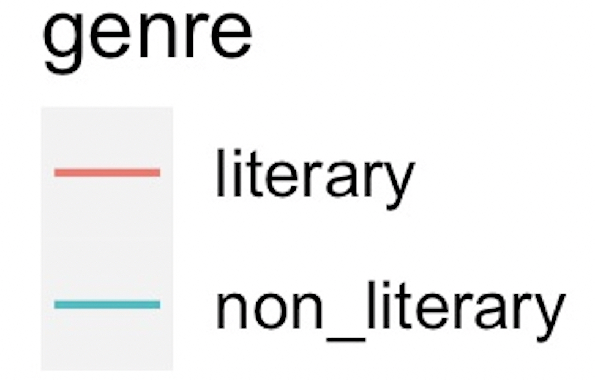
Key sites of development:
Frequency of prepositional phrases
240 texts from GiG corpus (Durrant & Brenchley, 2023)

Slide 31
Key sites of development:
Length of relative clauses
a planned event | executed by the Black Hand Gang
 |  | which consisted of 7 conspirators

Slide 32
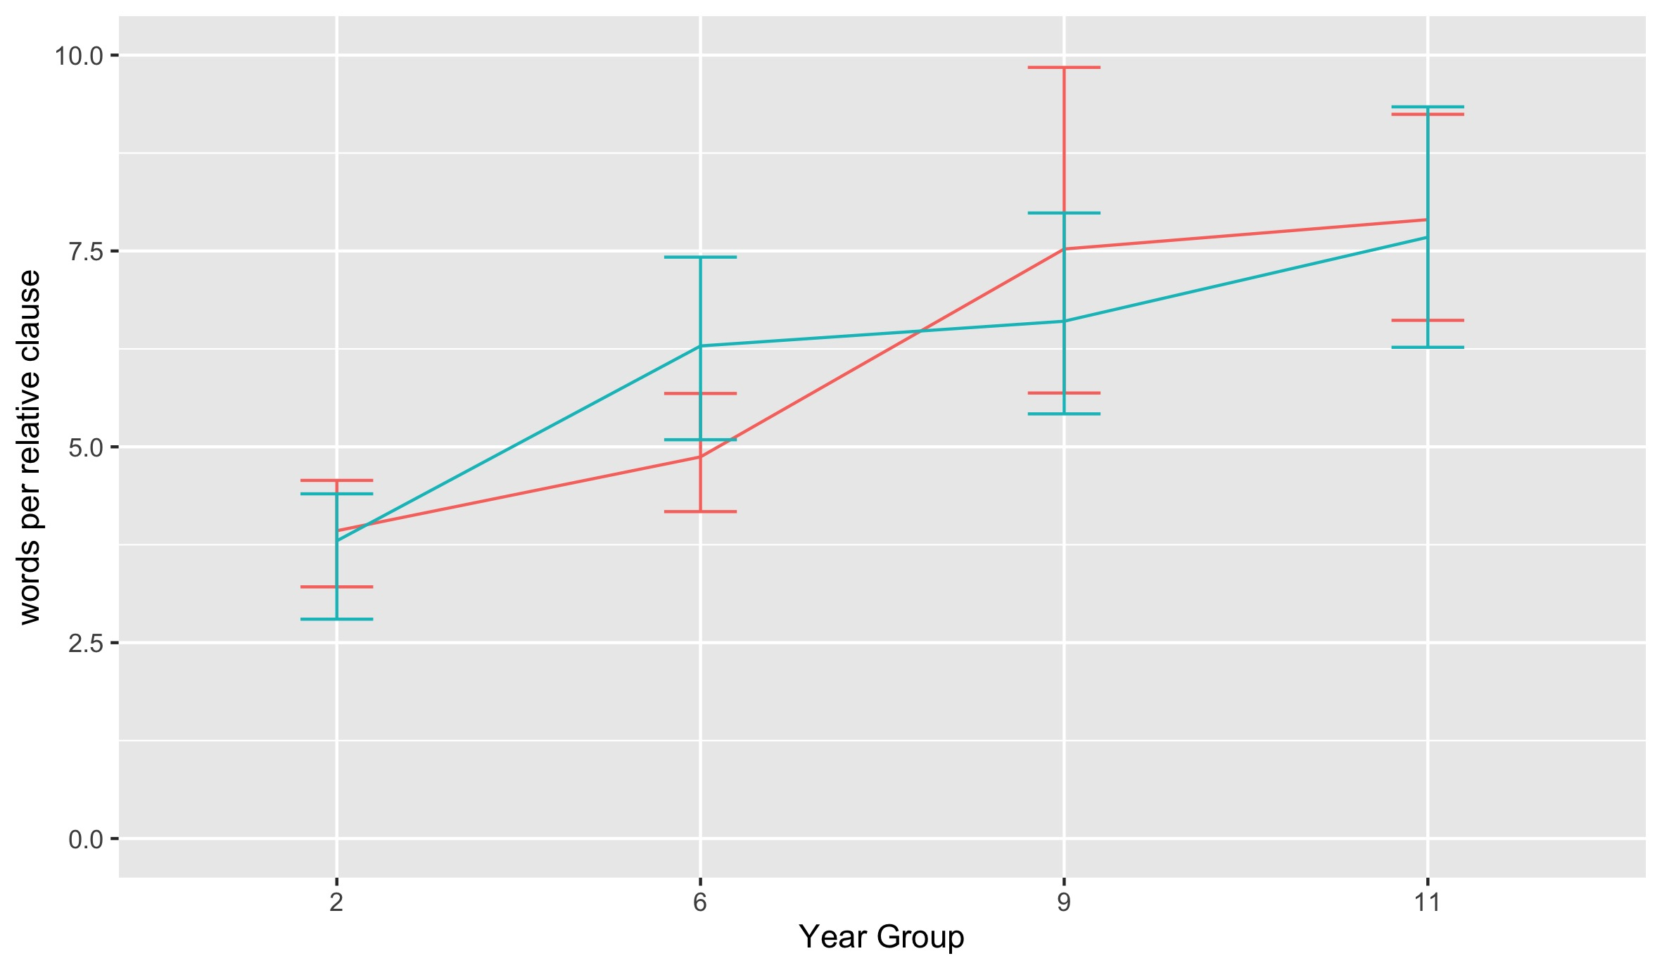
Key sites of development:
Length of relative clauses
240 texts from GiG corpus (Durrant & Brenchley, 2023)

Slide 33
It’s not over by Year 11

Slide 34
A ‘universal’ pattern of development
Across multiple studies in multiple contexts…
noun phrase complexity increases as writers progress
from KS1 to university and beyond.
In particular, there are increases in the frequency of prepositional phrases, the length of relative clauses, and noun premodifiers.
Durrant et al. 2021

Slide 35
So…
noun phrase complexity is a key element of mature academic language
which students need to use to meet academic expectations;
NP length can be used to index writing development;
development in NP complexity starts from KS1;
during school, number of prepositional phrases and length of relative clauses are particularly important sites of development;
key sites for development after Y11 are likely to be noun premodifiers and prepositional phrases.
Durrant et al. 2021

Slide 36
The future:
Understanding text type variation

Slide 37

It all becan in the crepy scary castle with sombys in it and bats init and you coud her sombys breving deply.
The gang with Fredd DafNy Scooby in the mystery machine went to visite the castle.
When they go out of the mystery machine they saw a somby in the castle with cobbwebs in the conrs of the castle the zomb was waked with one leg phind and his arms out and made a trap and it was the Joker and gang fond the polseis and they toock him to jall and they had a pizza party.

Slide 38

Should we go to bed at 7.30.??
We have been discussing whether children should go to bed at 7.30.
Many people believe that children should go to bed at 7.30 because firstly when you are rly erly wied erwack you will not be sleepy.
Secndly orso you will be at school erly in time.
Lastly when you eriv you will have a big smily on face and your tetcher will not shalt at you.
In conclooshen ther are lotes ov resens for and agnst gowing to bed at 7.30 because fristly some people think

Slide 39

Pour in the bath tub generously because the shiny tap is boiling hot.
Next quickly add bubbles before your furry mammoth gets overexited.
After that get your woolly mammoth into the unbakuble bath.
Then begin to srub your tickilish mammoth until he's clean.
Make a big splash so you lorg mammoth has a lot of FUN!
after wash his hair and dont foget to wash is hair.
Don't fuget to wash his give fat tummy and his ears. and try not to get any in his eyes
After throw in the towl and snuggle up.

Slide 40
Differences in language use between writing tasks is almost always greater than that between students in different year groups

Slide 41
For example…

Slide 42
Adverbials clauses of reason
Asprin reduces blood clotting as platelets are needed to clot the blood.
Dickens is saying that there is a great value in reading fictions books because "they kept him, many times, from what did him real harm", (Signor Jupe is the "him") and "he used to forget all his troubles".
They slapped the water with such force, people jumped out of their seats thinking it was a clap of thunder.

Slide 43
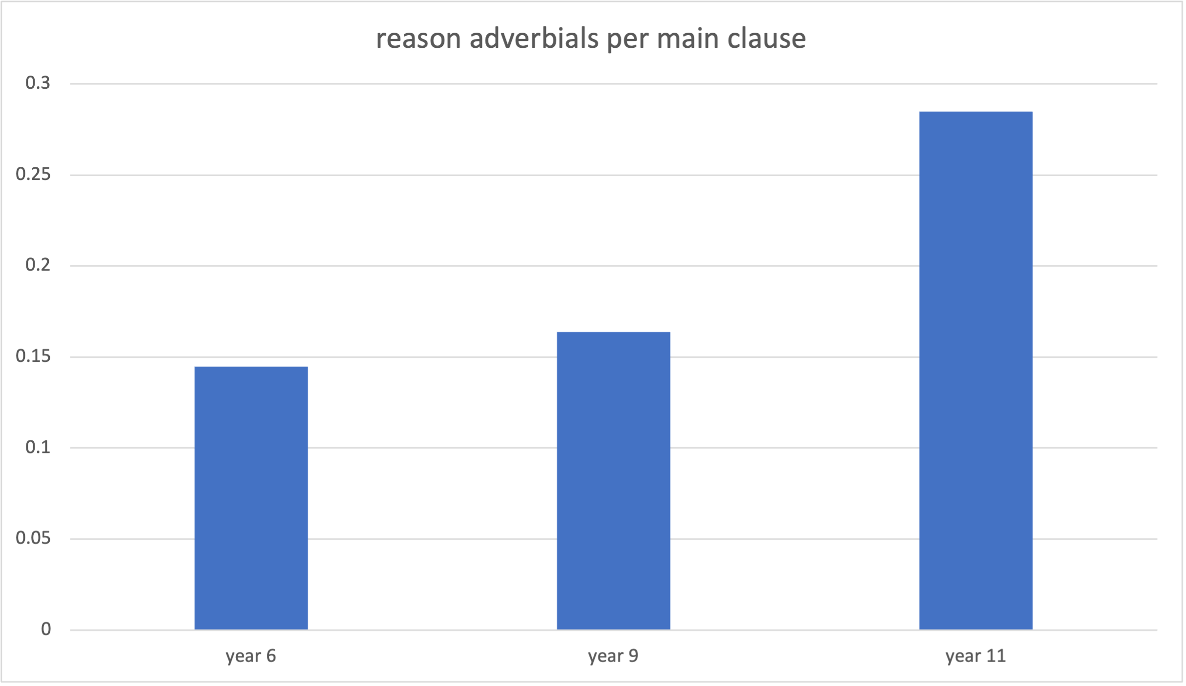
Reason clauses in non-literary writing
Durrant et al. 2020

Slide 44
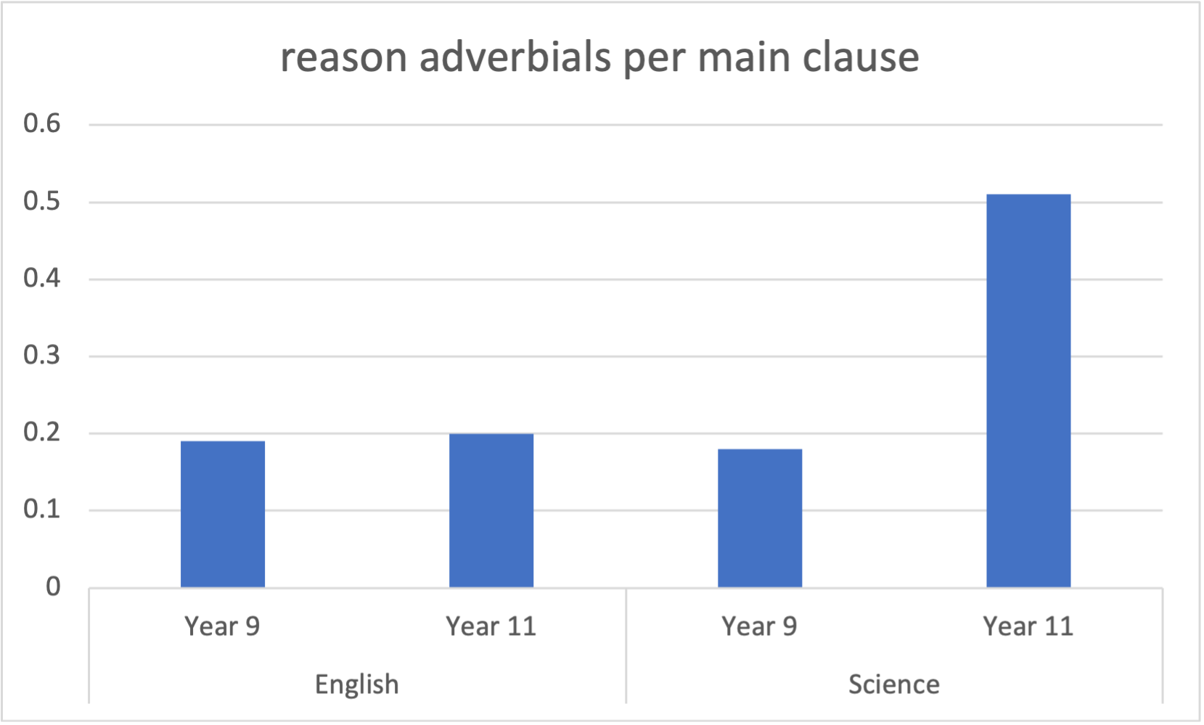
Adverbial clauses, genre & discipline
Durrant et al. 2020

Slide 45
Task types in science writing
Typical Year 9 tasks
Describe how Thashan is investigating the strength of electromagnets
A report on an investigation into the properties of bouncing balls
Typical Year 11 tasks
Look at the energy flow through the food chain…Explain how energy is lost from this food chain and why this limits the length of the food chain
Describe the similarities and differences between Graph A and Graph B and suggest reasons for these differences
Durrant et al. 2020

Slide 46
So…
Understanding language development at school requires understanding text type variation in a fine-grained way.

Slide 47
Also…
Specific task types pose specific language challenges
And offer specific learning opportunities
We need to understand diversity and overlaps in writing tasks

Slide 48
And…
students need to understand expectations of particular task types
teachers need to understand:
  the range of task types available
  the linguistic challenges/learning opportunities associated with these
  how task types vary / overlap across disciplines / year groups

Slide 49
But…

Slide 50
But…
there appears to be little consensus on what counts as central types of student writing or on how listed categories (e.g., ‘report’ or ‘argumentative essay’) ought to be defined.
Römer & O’Donnell (2011)
It seems that the registers that exist in university writing change with each new study
Goulart (in preparation)

Slide 51
Task type labels in studies of L1 child writing (1945 – 2015)
argument(ative); argumentative expository; classification; compare/contrast; creative; description/descriptive; essay; explanatory; explorative/exploratory; expository; expository letter; expressive; factual; imaginative; imaginative descriptive; informative/informational; literary response; narrative; narrative descriptive; opinionative discursive; persuasive/persuasion; procedure; reporting; story; technical explanatory
Durrant 2022

Slide 52
Examples of expository tasks
the child was asked to assume the role of a … nonfiction book scientist-writer and compose … an information report on a familiar topic (Fang, 2002)
Pretend you are a super hero and you are being interviewed on the news. Tell everyone what special powers you would have. Also, explain what you would do with them to help the world. (Hall-Mills & Apel, 2015)
Imagine that there is a large undeveloped space in your school yard. Every student in the school has been asked for ideas about what to put there. A committee of teachers and parents will choose the best suggestion. (Roessingh, Elgie, & Kover, 2015);
I like (person, place, or thing)______ because _______. (Yates, Berninger, & Abbott, 1995)
Participants…were asked to give their ideas and thoughts on the topic of “problems between people” and were explicitly instructed not to tell or write a story but to discuss the issue (Berman & Nir-Sagiv, 2007)
Durrant 2022

Slide 53
Definitions of expository
expresses factual information in order to inform or explain (Cox et al., 1991)
argues for a point of view (Rose & Martin, 2012)
conveying facts or describing procedures, sharing basic information, relating cause-effect relationships, or arguing a point of view (Hall-Mills & Apel, 2015)
Durrant 2022

Slide 54
Why is this so difficult to get right?
Variation within text types
Text types are dynamic
Many real texts don’t belong to a single category
Transgressing boundaries/hybridisation can be a marker of maturity (e.g., Bazerman et al., 2018; Berman & Verhoeven, 2002)
Classification requires interpretation

Slide 55
some proto-solutions

Slide 56
some proto-solutions
We see [text] categories not as a set of pigeon holes into one of which any piece of writing can be deposited, but rather as multidimensional, that is a piece of writing can be located at different places on a set of axes
(Britton et al. 1975, p.12)

Slide 57
some proto-solutions
The topological approach…takes into account overlaps and similarities and locates items on gradients of similarity along various functional parameters. Rather than imposing boundaries of difference, such an approach maps degrees of similarity. It models choice in terms of tendencies and degrees rather than with with dichotomous (either/or) terms available within a typological system network
(Coffin, 2006, p.46)

Slide 58
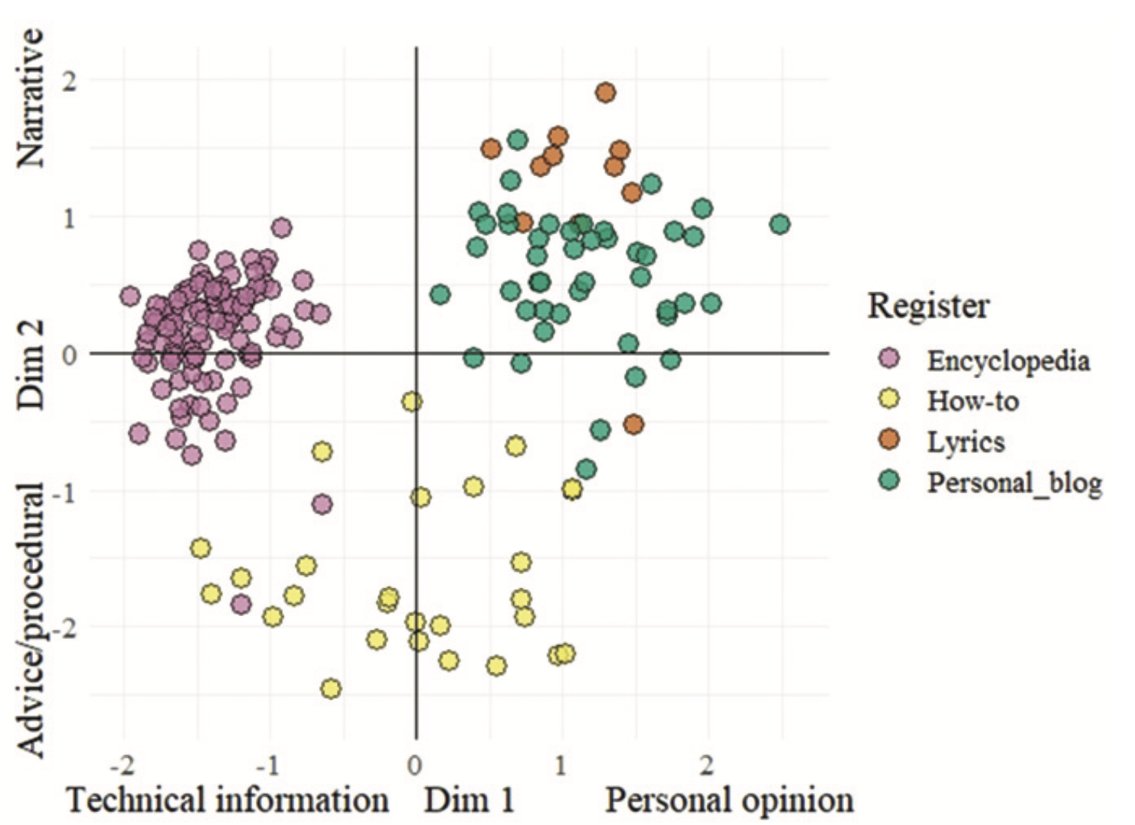
Text types in continuous multidimensional space
Biber et al, 2020

Slide 59
Detailed profile of texts in terms of
Functions
Focus
Sources
Extra-textual content
Medium
Relationships
Task requirements

Slide 60
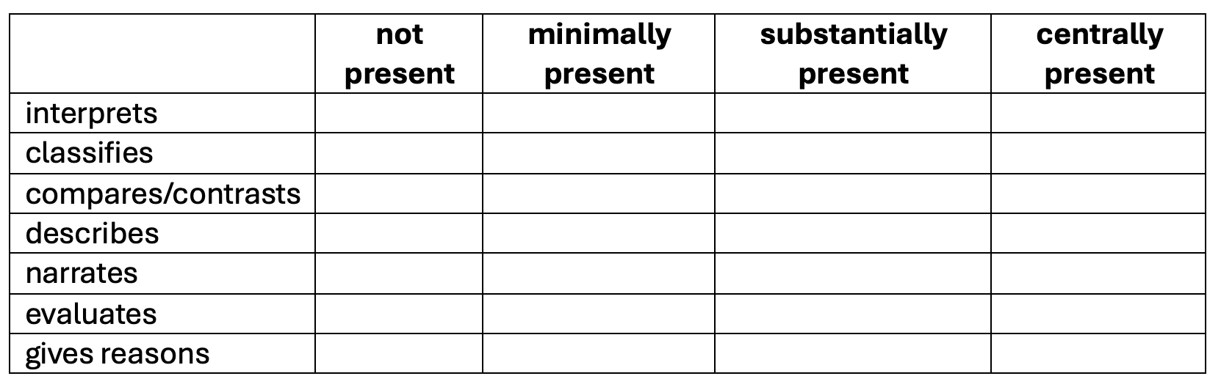
Functions
The text…

Slide 61
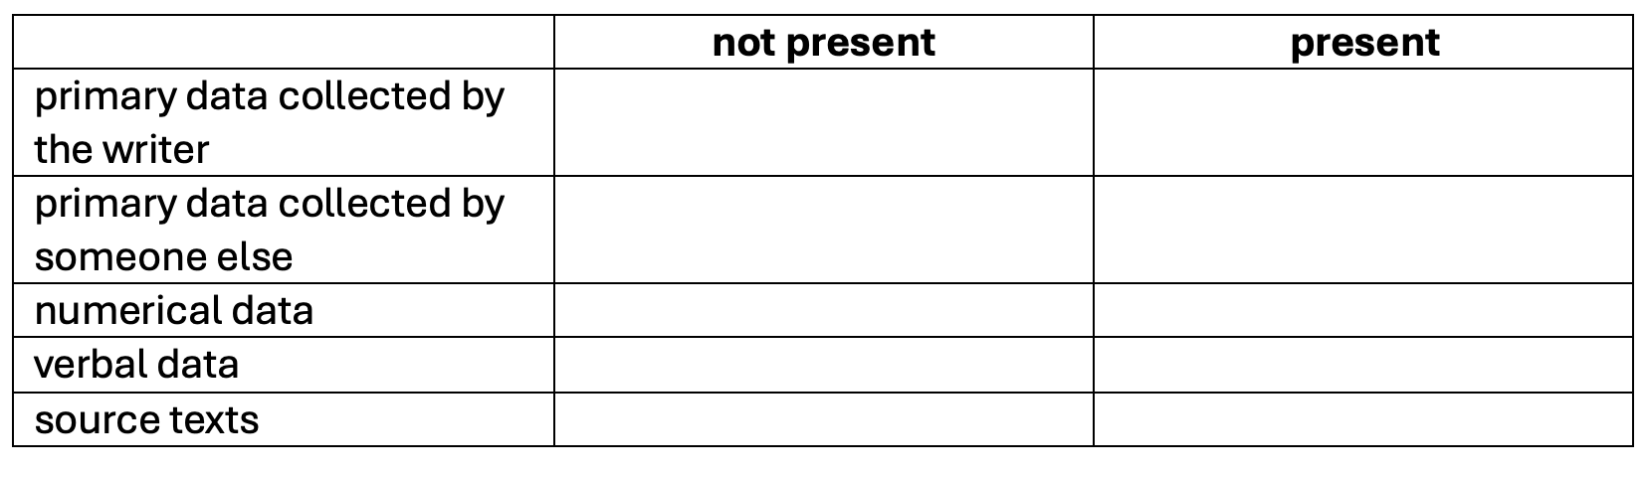
Sources
The text is based on…

Slide 62
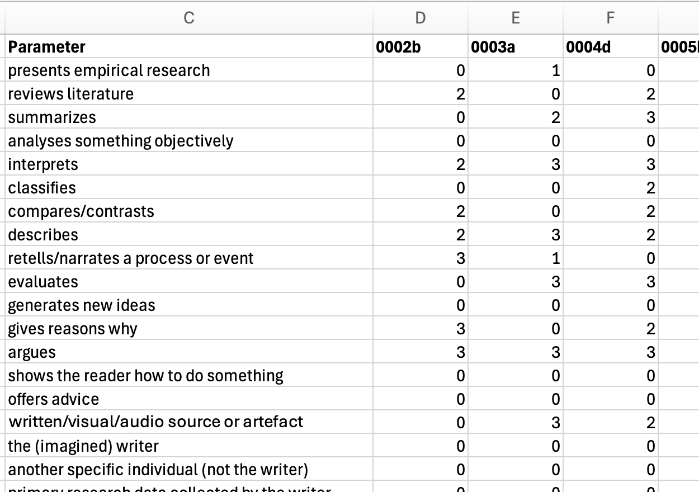

Slide 63
Illustrative findings

Slide 64

Illustrative findings

Slide 65
Illustrative findings
Factor 1
primary research data collected by the writer | .77
primary research data: numerical | .66
presents empirical research | .45
primary research data: verbal | .44
describes | .43
retells/narrates a process or event | .42
reviews literature | .34
primary research data collected by someone else | .33
non verbal material | .32
argues | -.37

Slide 66
Illustrative findings
Factor 2
summarizes | 0.81
reviews literature | 0.76
source texts | 0.47
quotations | 0.39
non verbal material | -0.33
requires a series of answers to separate prompts/questions | -0.33
analyses something objectively | -0.50

Slide 67
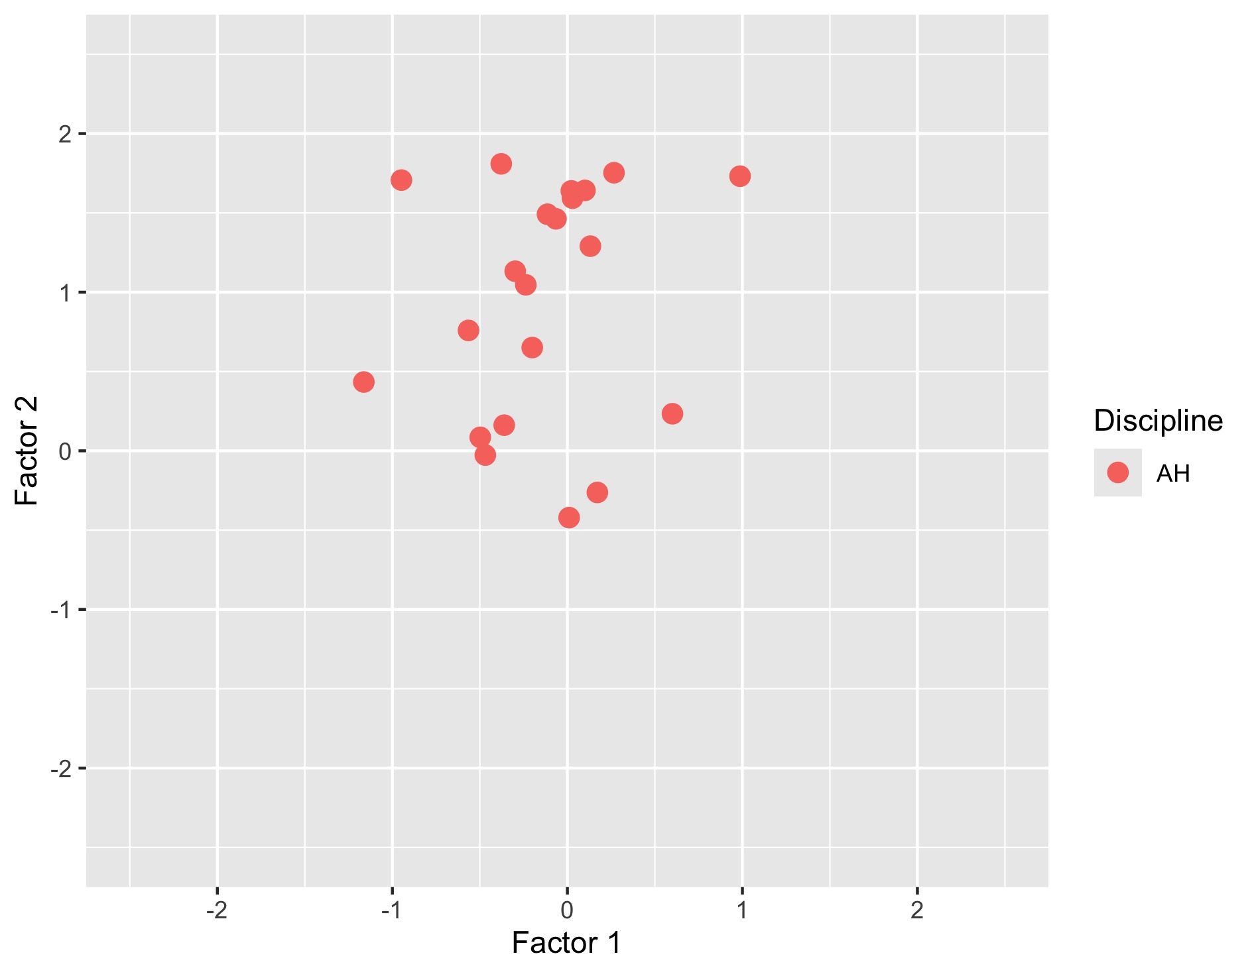

Slide 68
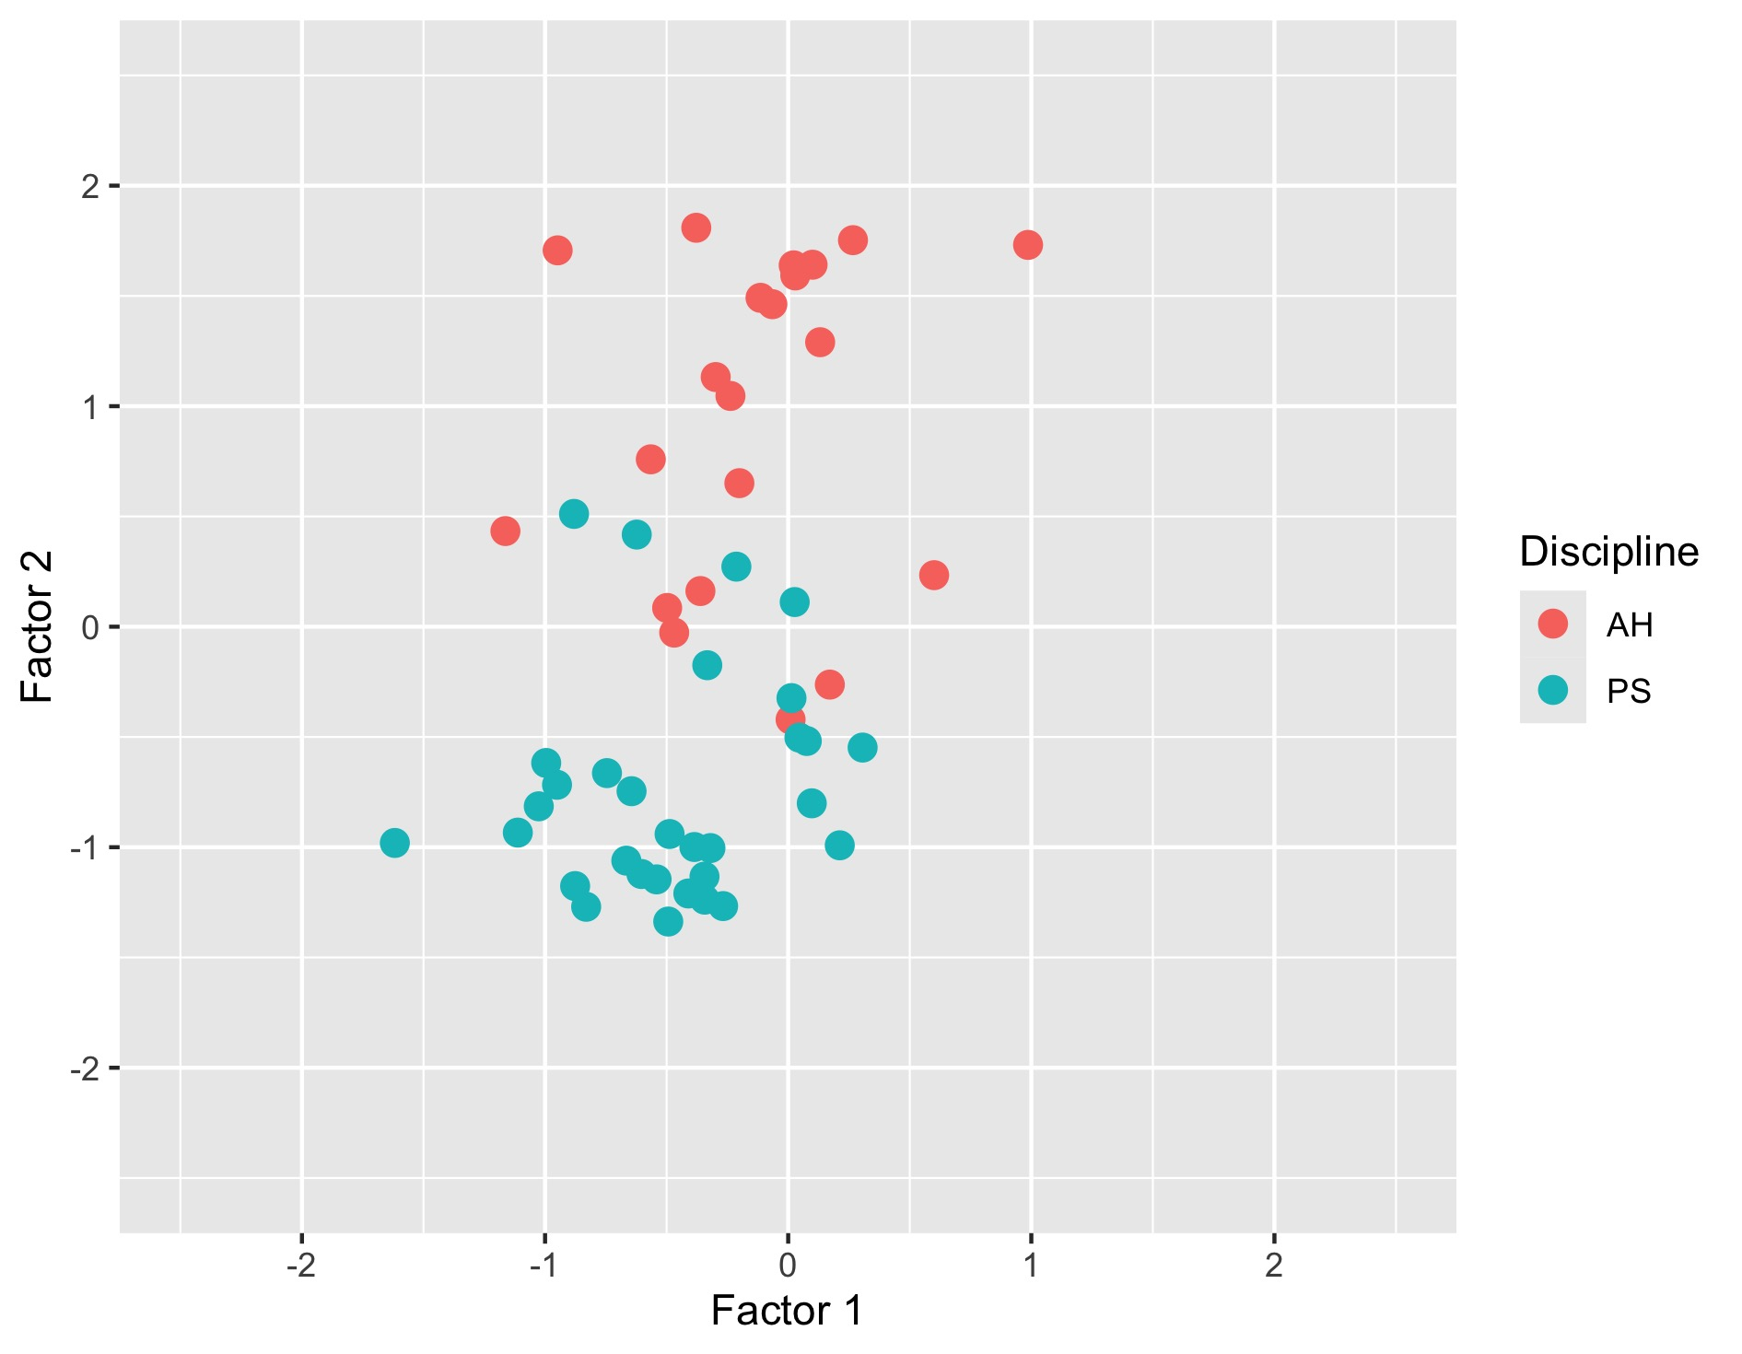

Slide 69
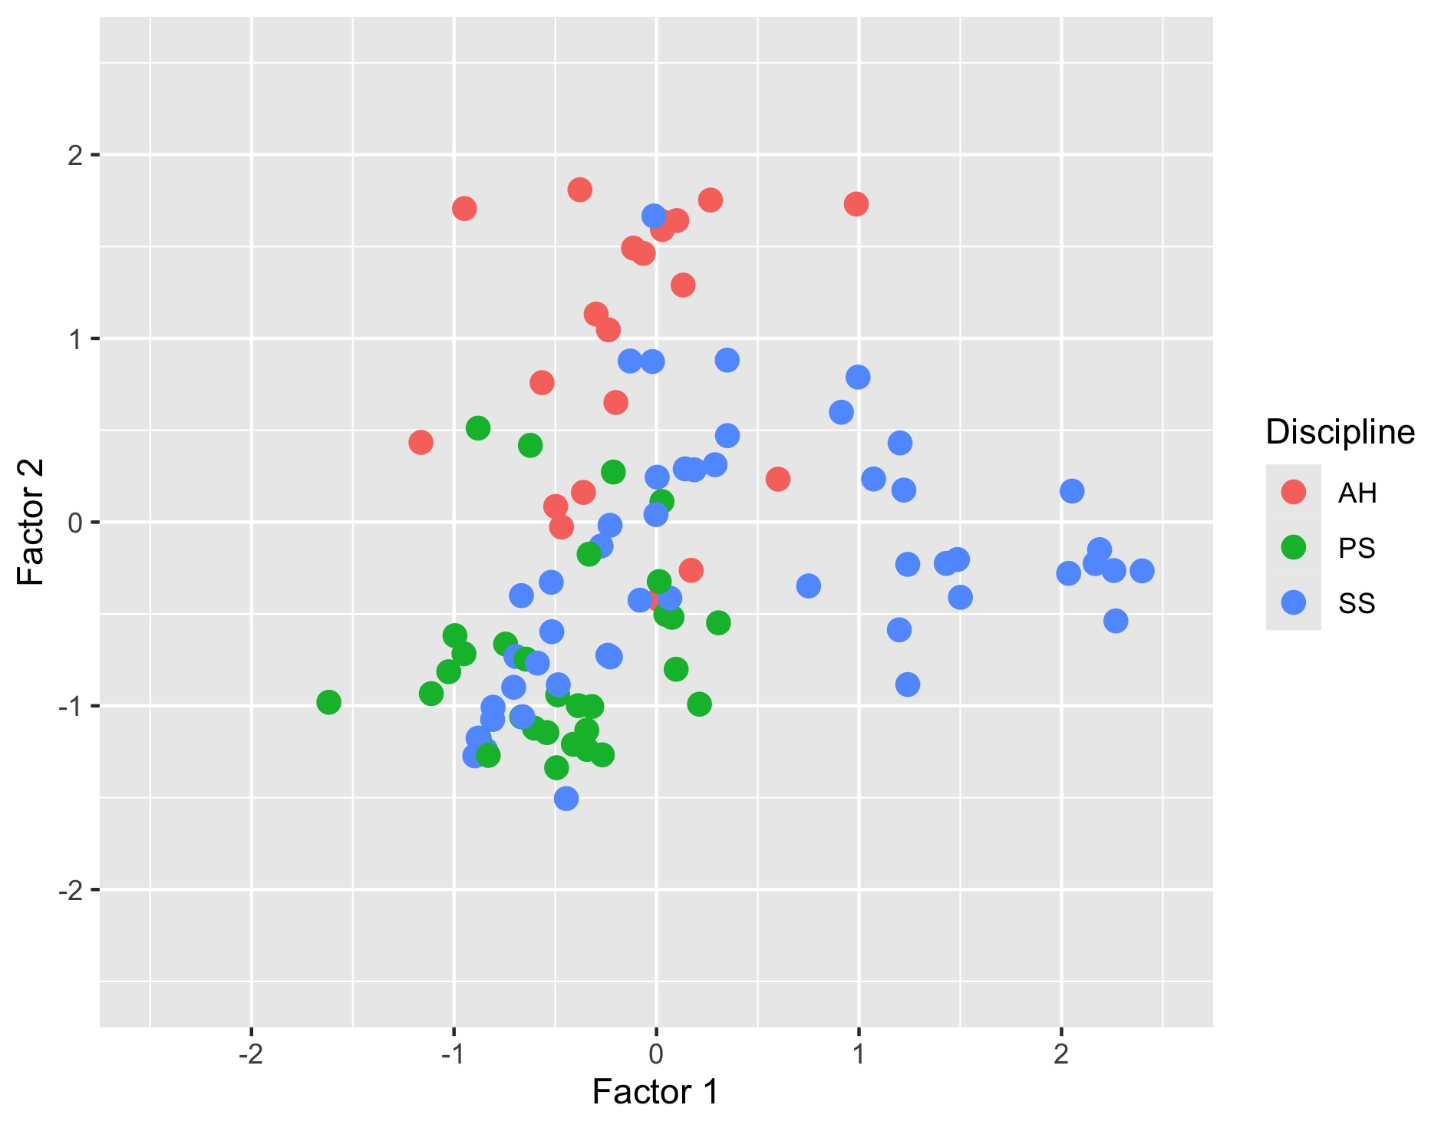

Slide 70
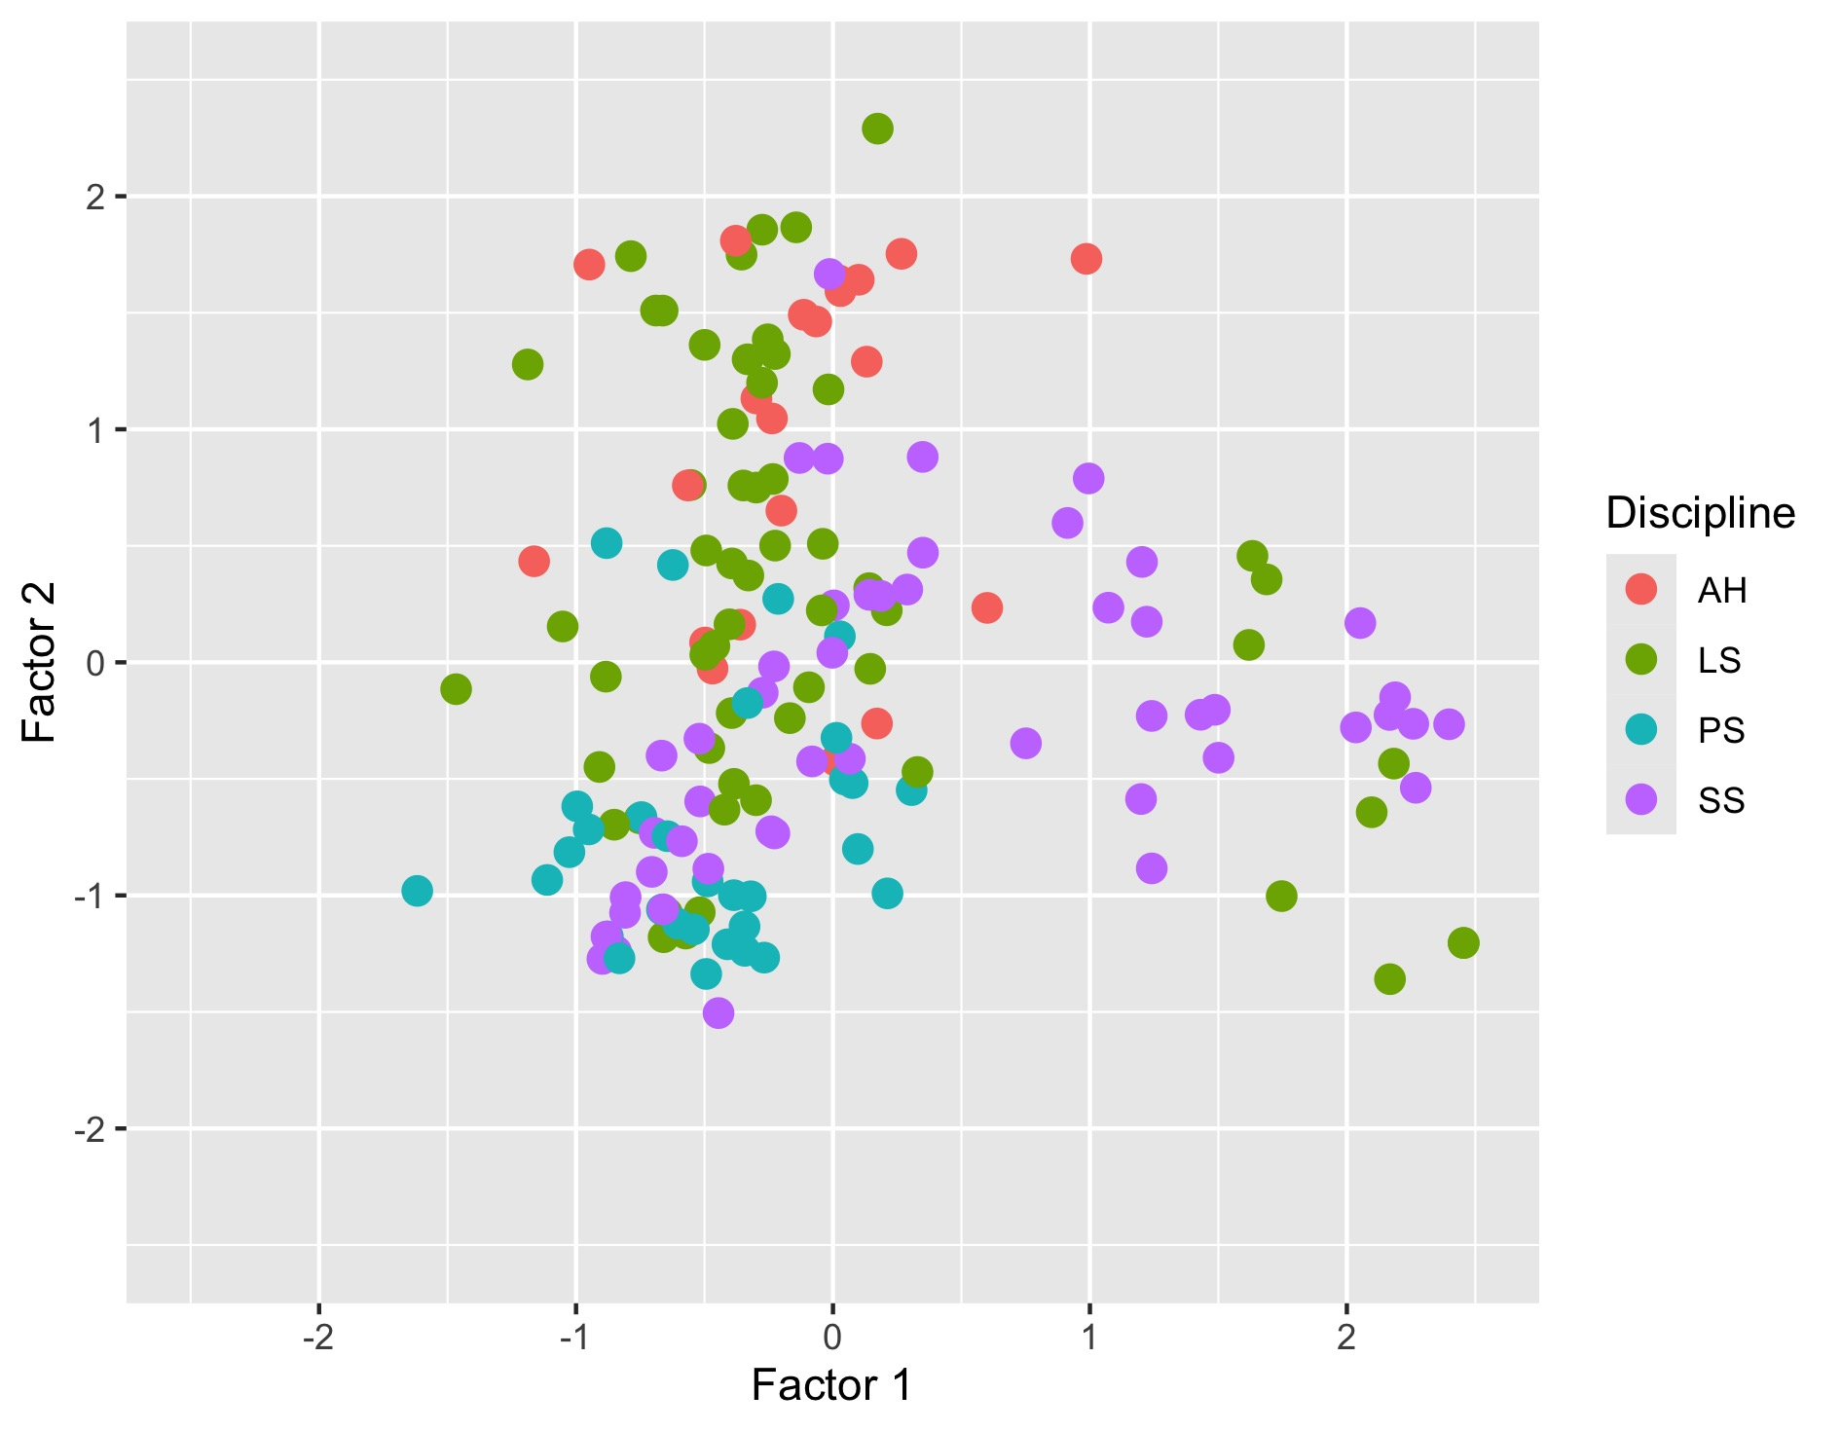

Slide 71
Some aims for the future
Developing a tool for profiling texts across contexts
Mapping educational texts types at school and university
Correlating axes of text type variation to features of language
Understanding how teachers / students interpret text types

Slide 72
References
Biber, D., Egbert, J., & Keller, D. (2020). Reconceptualizing register in a continuous situational space. Corpus linguistics and linguistic theory, 16(3), 581-616.
Biber, D., Johansson, S., Leech, G., Conrad, S., & Finegan, E. (2021). Grammar of spoken and written English. Amsterdam: John Benjamins Publishing Company.
Britton, J., Burgess, T., Martin, N., & Rosen, H. (1975). The development of writing abilities 11-18: Macmillan.
Coffin, C. (2006). Historical Discourse: The Language of Time, Cause and Evaluation. London: Continuum.
Durrant, P. (2022). Studying children’s writing development with a corpus. Applied Corpus Linguistics.
Durrant, P., & Brenchley, M. (2023). Development of noun phrase complexity across genres in children’s writing. Applied Linguistics, 44(2), 239 - 264.
Durrant, P., Brenchley, M., & Clarkson, R. (2020). Syntactic development across genres in children's writing: The case of adverbial clauses. Journal of Writing Research, 12(2), 419-452.
Durrant, P., Brenchley, M., & McCallum, L. (2021). Understanding development and proficiency in writing: quantitative corpus linguistic approaches. Cambridge: Cambridge University Press.
Goulart, L. (in preparation). Variation in University Student Writing: John Benjamins.
Myhill, D. (1999). Writing matters: linguistic characteristics of writing in GCSE English examinations. English in Education, 33(3).
Rivera, C. (2007). Foreward. In A. L. Bailey (Ed.), The Language Demands of School: Putting academic English to the test. New Haven & London: Yale University Press.
Römer, U., & O’Donnell, M. B. (2011). From student hard drive to web corpus (part 1): the design, compilation and genre classification of the Michigan Corpus of Upper-level Student Papers (MICUSP). Corpora, 6(2), 159-177.

Slide 73
Thank you!
p.l.durrant@exeter.ac.uk

