Slide 1
Mapping text types in academic writing
Phil Durrant

Slide 2

Academic language as gatekeeper
The ability to use the specialized language of the academic sphere is like a gatekeeper: it opens doors for those who have it, and fastens them shut for those who do not.
Stanford teacher education program, cited in Rivera, 2007

Slide 3
So what can applied linguists do?

Slide 4
1. Create explicit knowledge of
linguistic challenges
linguistic opportunities

Slide 5
So that we can…
develop strategies for dealing with challenges…
…and for maximizing learning opportunities.
And critique expectations.

Slide 6
2. Show the big picture…
how language demands differ / overlap across subject areas,
and educational levels.

Slide 7
So that we can…
make links across the curriculum
…and with past and future learning.

Slide 8
3. Create explicit knowledge of…
what is valued in assessments

Slide 9
So that we can…
understand/evaluate/compare outcomes
promote fair, transparent, assessment

Slide 10
And we should be curious about…
how the socio-epistemic structures of education shape language use;
what language use tells us about those educational structures;
how students learn to express complex, abstract ideas, take a stance, argue for a point, and establish relationships with imagined readers

Slide 11
A key challenge:
Understanding text type variation

Slide 12

Should we go to bed at 7.30.??
We have been discussing whether children should go to bed at 7.30.
Many people believe that children should go to bed at 7.30 because firstly when you are rly erly wied erwack you will not be sleepy.
Secndly orso you will be at school erly in time.
Lastly when you eriv you will have a big smily on face and your tetcher will not shalt at you.
In conclooshen ther are lotes ov resens for and agnst gowing to bed at 7.30 because fristly some people think

Slide 13
Should we go to bed at 7.30.??
We have been discussing whether children should go to bed at 7.30.
Many people believe that children should go to bed at 7.30 because firstly when you are rly erly wied erwack you will not be sleepy.
Secndly orso you will be at school erly in time.
Lastly when you eriv you will have a big smily on face and your tetcher will not shalt at you.
In conclooshen ther are lotes ov resens for and agnst gowing to bed at 7.30 because fristly some people think

Slide 14
Should we go to bed at 7.30.??
We have been discussing whether children should go to bed at 7.30.
Many people believe that children should go to bed at 7.30 because firstly when you are rly erly wied erwack you will not be sleepy.
Secndly orso you will be at school erly in time.
Lastly when you eriv you will have a big smily on face and your tetcher will not shalt at you.
In conclooshen ther are lotes ov resens for and agnst gowing to bed at 7.30 because fristly some people think

Slide 15
Should we go to bed at 7.30.??
We have been discussing whether children should go to bed at 7.30.
Many people believe that children should go to bed at 7.30 because firstly when you are rly erly wied erwack you will not be sleepy.
Secndly orso you will be at school erly in time.
Lastly when you eriv you will have a big smily on face and your tetcher will not shalt at you.
In conclooshen ther are lotes ov resens for and agnst gowing to bed at 7.30 because fristly some people think

Slide 16
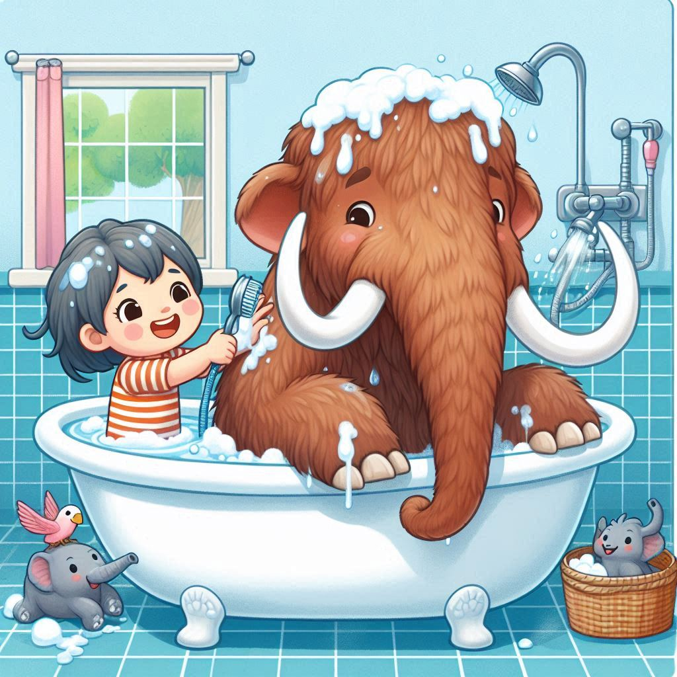
Pour in the bath tub generously because the shiny tap is boiling hot.
Next quickly add bubbles before your furry mammoth gets overexited.
After that get your woolly mammoth into the unbakuble bath.
Then begin to srub your tickilish mammoth until he's clean.
Make a big splash so you lorg mammoth has a lot of FUN!
after wash his hair and dont foget to wash is hair.
Don't fuget to wash his give fat tummy and his ears. and try not to get any in his eyes
After throw in the towl and snuggle up.

Slide 17
Pour in the bath tub generously because the shiny tap is boiling hot.
Next quickly add bubbles before your furry mammoth gets overexited.
After that get your woolly mammoth into the unbakuble bath.
Then begin to srub your tickilish mammoth until he's clean.
Make a big splash so you lorg mammoth has a lot of FUN!
after wash his hair and dont foget to wash is hair.
Don't fuget to wash his give fat tummy and his ears. and try not to get any in his eyes
After throw in the towl and snuggle up.

Slide 18
Pour in the bath tub generously because the shiny tap is boiling hot.
Next quickly add bubbles before your furry mammoth gets overexited.
After that get your woolly mammoth into the unbakuble bath.
Then begin to srub your tickilish mammoth until he's clean.
Make a big splash so you lorg mammoth has a lot of FUN!
after wash his hair and dont foget to wash is hair.
Don't fuget to wash his give fat tummy and his ears. and try not to get any in his eyes
After throw in the towl and snuggle up.

Slide 19
Models of academic language need to incorporate task type variation.

Slide 20
Also, educators need to understand how…
specific task types pose specific language challenges
and offer specific learning opportunities
what types are common across year groups / disciplines

Slide 21
But…
there appears to be little consensus on what counts as central types of student writing or on how listed categories (e.g., ‘report’ or ‘argumentative essay’) ought to be defined.
Römer & O’Donnell (2011)

Slide 22
For example: expository writing
the child was asked to assume the role of a … nonfiction book scientist-writer and compose … an information report on a familiar topic (Fang, 2002)
Pretend you are a super hero and you are being interviewed on the news. Tell everyone what special powers you would have. Also, explain what you would do with them to help the world (Hall-Mills & Apel, 2015)
Imagine that there is a large undeveloped space in your school yard. Every student in the school has been asked for ideas about what to put there. A committee of teachers and parents will choose the best suggestion (Roessingh, Elgie, & Kover, 2015)
I like (person, place, or thing)______ because _______ (Yates, Berninger, & Abbott, 1995)

Slide 23
Why is this so difficult to get right?
Text types are dynamic and internally diverse
Many real texts don’t belong to a single category
Transgressing boundaries/hybridisation can be a marker of maturity (e.g., Bazerman et al., 2018; Berman & Verhoeven, 2002)
Classification requires complex interpretation

Slide 24
A way forward: non-categorical text types
“We classify at out peril” (Britton et al. 1975, p.1)

Slide 25
We see [text] categories not as a set of pigeon holes into one of which any piece of writing can be deposited, but rather as multidimensional, that is a piece of writing can be located at different places on a set of axes
(Britton et al. 1975, p.12)

Slide 26
The topological approach…takes into account overlaps and similarities and locates items on gradients of similarity along various functional parameters. Rather than imposing boundaries of difference, such an approach maps degrees of similarity. It models choice in terms of tendencies and degrees rather than with with dichotomous (either/or) terms available within a typological system network
(Coffin, 2006, p.46)

Slide 27

Implementing this
(inspired by Biber et al. 2020)

Slide 28
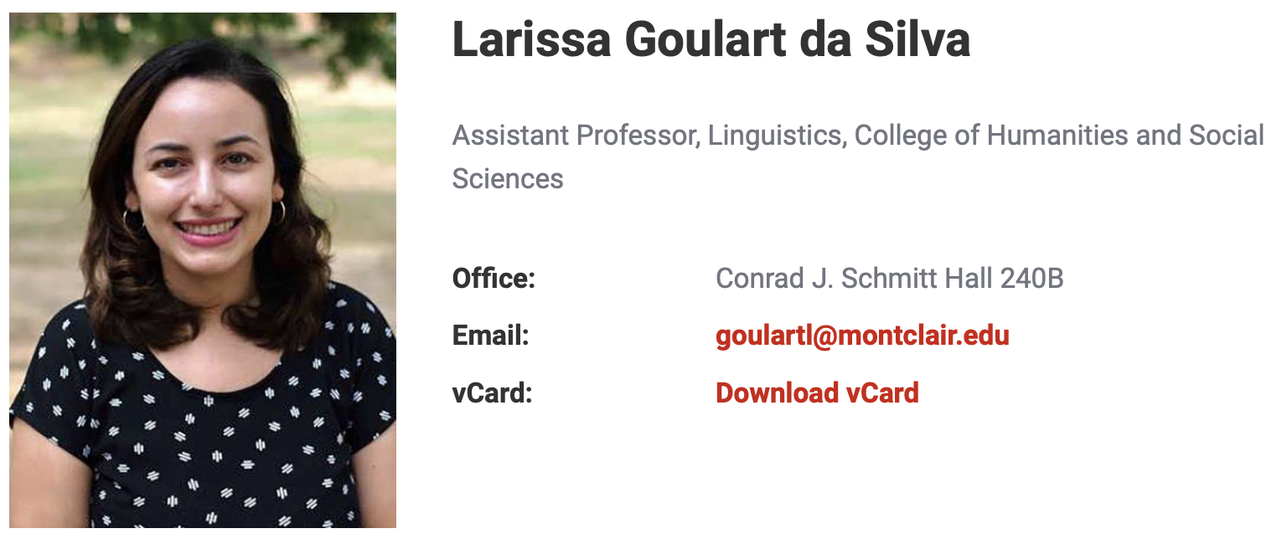




Slide 29
Step 1: define possible distinctive features

Slide 30
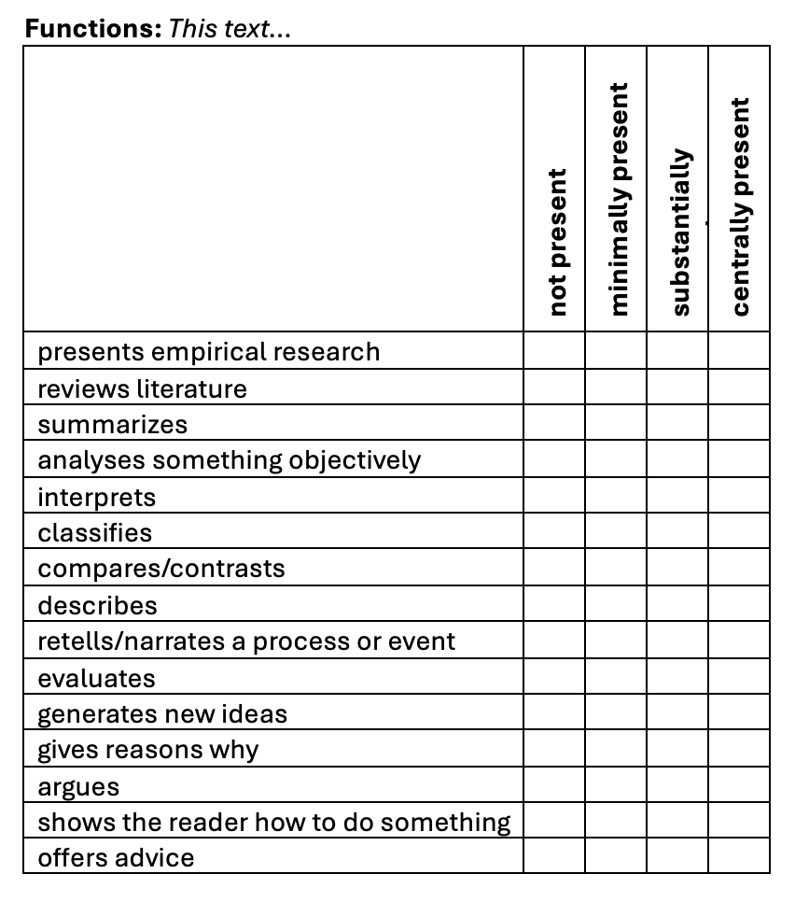
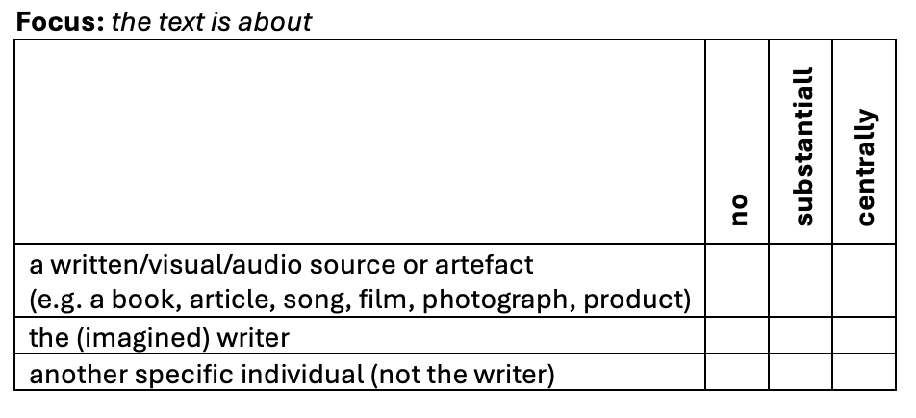
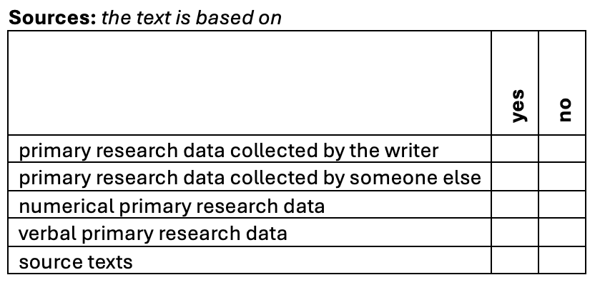
Step 1: define possible distinctive features

Slide 31
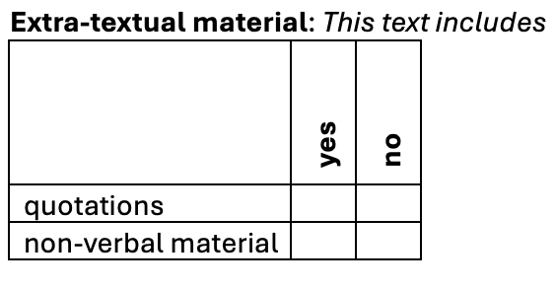
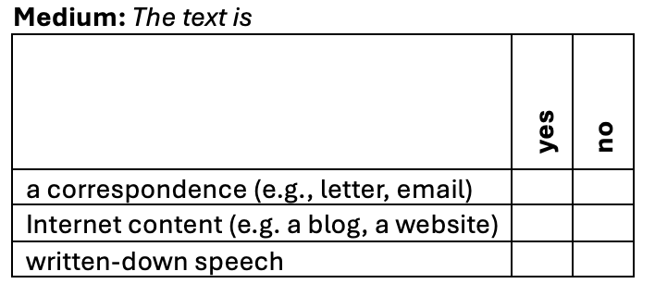
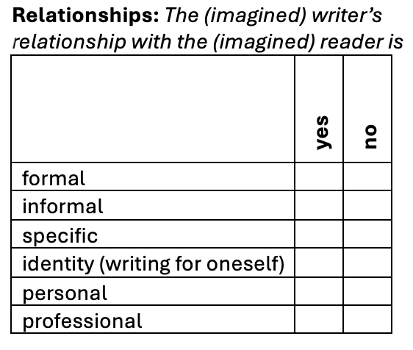
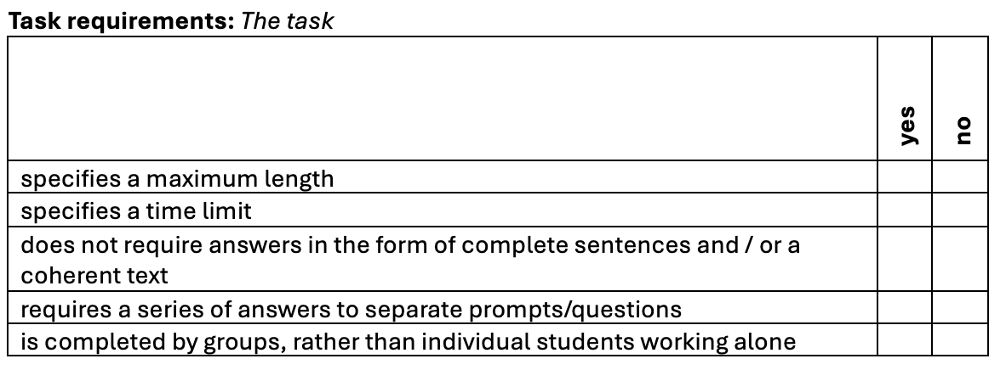

Slide 32
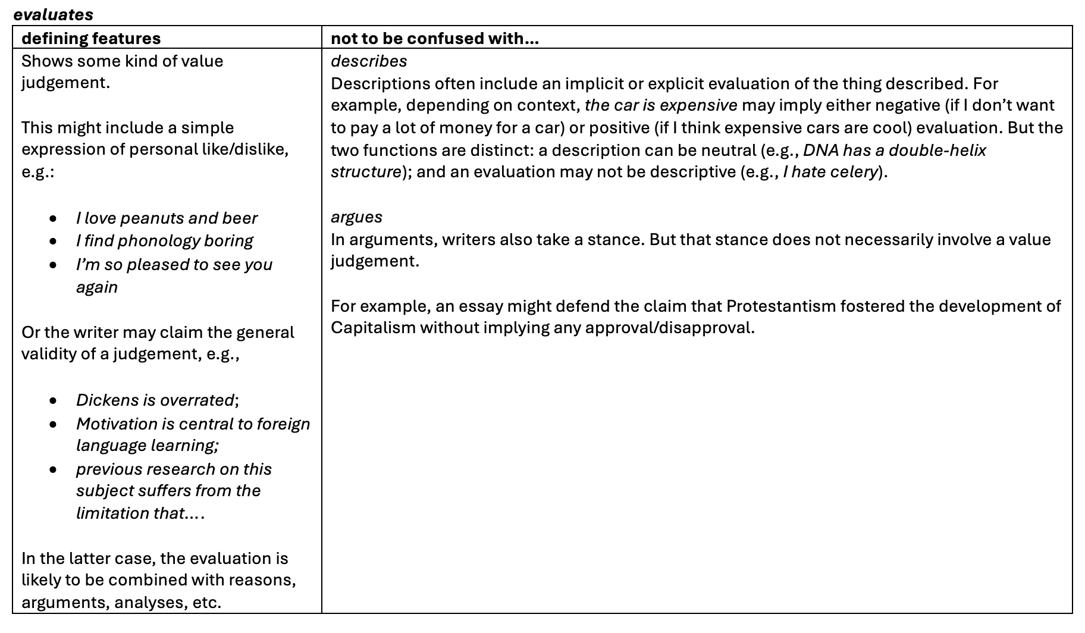

Slide 33
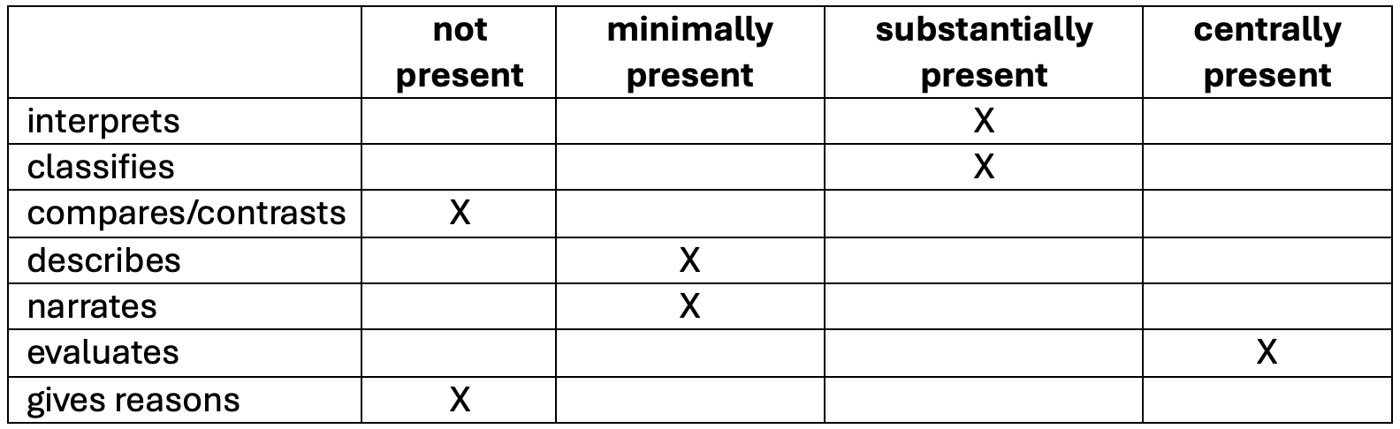
Step 2: Rate texts on each feature

Slide 34
Texts sampled from BAWE corpus
 | Arts & Hums | Life Sciences | Physical Sciences | Social Sciences | Total
case study | 0 | 12 | 12 | 12 | 36
critique | 9 | 9 | 9 | 9 | 36
design specification | 0 | 0 | 36 | 0 | 36
empathy writing | 1 | 19 | 9 | 3 | 32
essay | 9 | 9 | 9 | 9 | 36
exercise | 9 | 9 | 9 | 9 | 36
explanation | 9 | 9 | 9 | 9 | 36
literature survey | 7 | 14 | 4 | 10 | 35
methodology recount | 9 | 9 | 9 | 9 | 36
narrative recount | 8 | 9 | 9 | 9 | 35
problem question | 0 | 1 | 3 | 32 | 36
proposal | 0 | 12 | 12 | 12 | 36
research report | 9 | 9 | 9 | 9 | 36
Total | 70 | 121 | 139 | 132 | 462

Slide 35
Step 3: Factor analysis
For 20 parameters found in > 5% texts and with > 70% agreement
4 factors explained 38% of variance:
  library research vs. short answers (12%)
  quantitative research vs. involved writing (11%)
  reporting empirical research (9%)
  personal informal writing (6%)

Slide 36
Factor 1:
Library research
vs.
Short-answers
 | structure loading
reviews literature | .78
summarizes | .77
source texts | .71
quotations | .53
primary research data collected by someone else | .36
requires a series of answers to separate prompts questions | -.28
non-verbal material | -.30
(12% of total variance)

Slide 37
For example…
“a broad sweep of the most important literature on this topic [Herodotus and Egypt] over time from the late nineteenth century to the present”
(Classics, M-level: F1=2.43)

Slide 38
For example…
Question 2
Please see attachment - page 2. The series converges to 0.35 (only correct to 2 d.p. with 3000 terms, and 0.3466 with 30000 terms).
Please see attachment - page 3. The second series added to the graph is: FORMULA .
(Mathematics, Y1, F1 = -1.66)

Slide 39
Factor 2:
Quantitative research
vs.
Involved writing
 | structure loading
numerical primary research data | 0.78
presents empirical research | 0.54
primary research data collected by someone else | 0.52
non-verbal material | 0.52
compares / contrasts | 0.36
primary research data collected by the writer | 0.32
informal | -0.30
focus on the imagined writer | -0.31
focus on another specific individual (not the writer) | -0.36
(11% of total variance)

Slide 40
For example
“a cross sectional data analysis for 40 low to middle income countries” analysing the effects of manufacturing on GDP growth and “what elements determine manufacturing exports and thus what implications these might have on policy making”
(Economics, Y1, F: 2.16)

Slide 41
For example…
In order to start your scheme, we should explain several procedures before any construction can begin. To fulfil your requirements for the project we need to develop your ideas into actual plans. These then should submitted to the local authority…
(Architecture, Y3, F2 = -1.89)

Slide 42
Multidimensionalty:
Factor 1 vs Factor 2
(r = -.01)

Slide 43
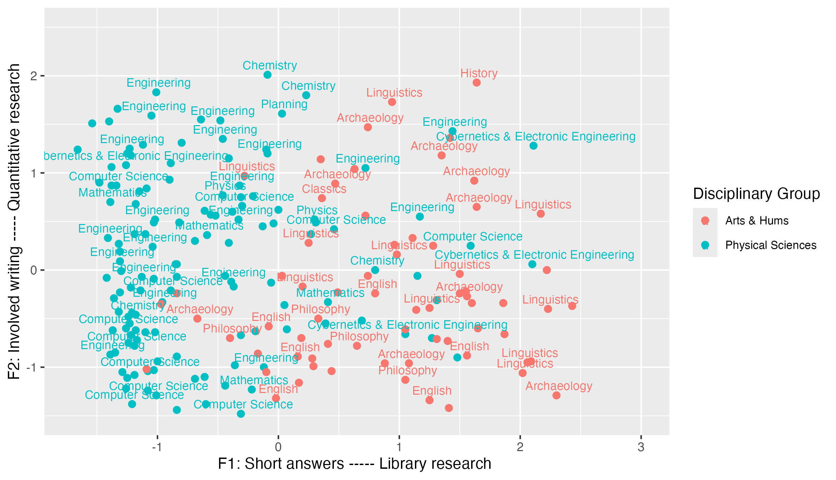

Slide 45
“(i) The graph below shows the daily prices on the New York Stock Exchange of the General Electric common stock from December 1999 to December 2000. This time series consists of 253 values. The series seems to fit pretty well the standard behaviour of a stock price series. The series appears to have a lot of local behaviour, with fluctuations around a local level and drift in level behaviour over the course of the series.”
(Mathematics, M-level, F1: -1.33; F2: 1.66)

Slide 47
“The intention of this paper is move outward from new and old statistical empirical evidence, found on the one hand in the National Archives (PRO) and the RAF Museum Archive, and on the other, in existing secondary literature, and ask what this reveals about British air strategy in the 1920s and 1930s. The methodology used is to take researched evidence, portray it in the form of charts, data bases or spreadsheets, and then use this IT generated information as the foundation for discussion.”
(History, M-level, F1: 1.64; F2: 1.93)

Slide 49
Critical Review of Barbara Benders paper Theorising Landscapes and the Prehistoric Landscapes of Stonehenge.
…Her style is at times confusing and presents her case in an overly complicated manner. She does inspire the reader to look at landscapes and buildings/monuments in a new and exciting way. Her post - processual viewpoint is very obvious and can easily be criticised as it pulls together so many arguments it is not necessarily very concise.
(Archaeology, Y2, F1: 2.3; F2: -1.29)

Slide 51
Resource Management: Initially the plan for the second part of the project was to complete the design totally then begin implementation, iterating the analysis, design and implementation as required. Having completed an initial analysis for part one of the project, we felt it would be preferable to…
Source Code Control: For the majority of the project (i.e. until integration testing began), our source code was split into two basic parts…
Installing, Compiling and Executing: In order to compile the code initially, the code controller first…
(Computer Science, Y3, F1: -1.26, F2: -1.22)

Slide 52
Literature Surveys &
Methodology Recounts

Slide 53
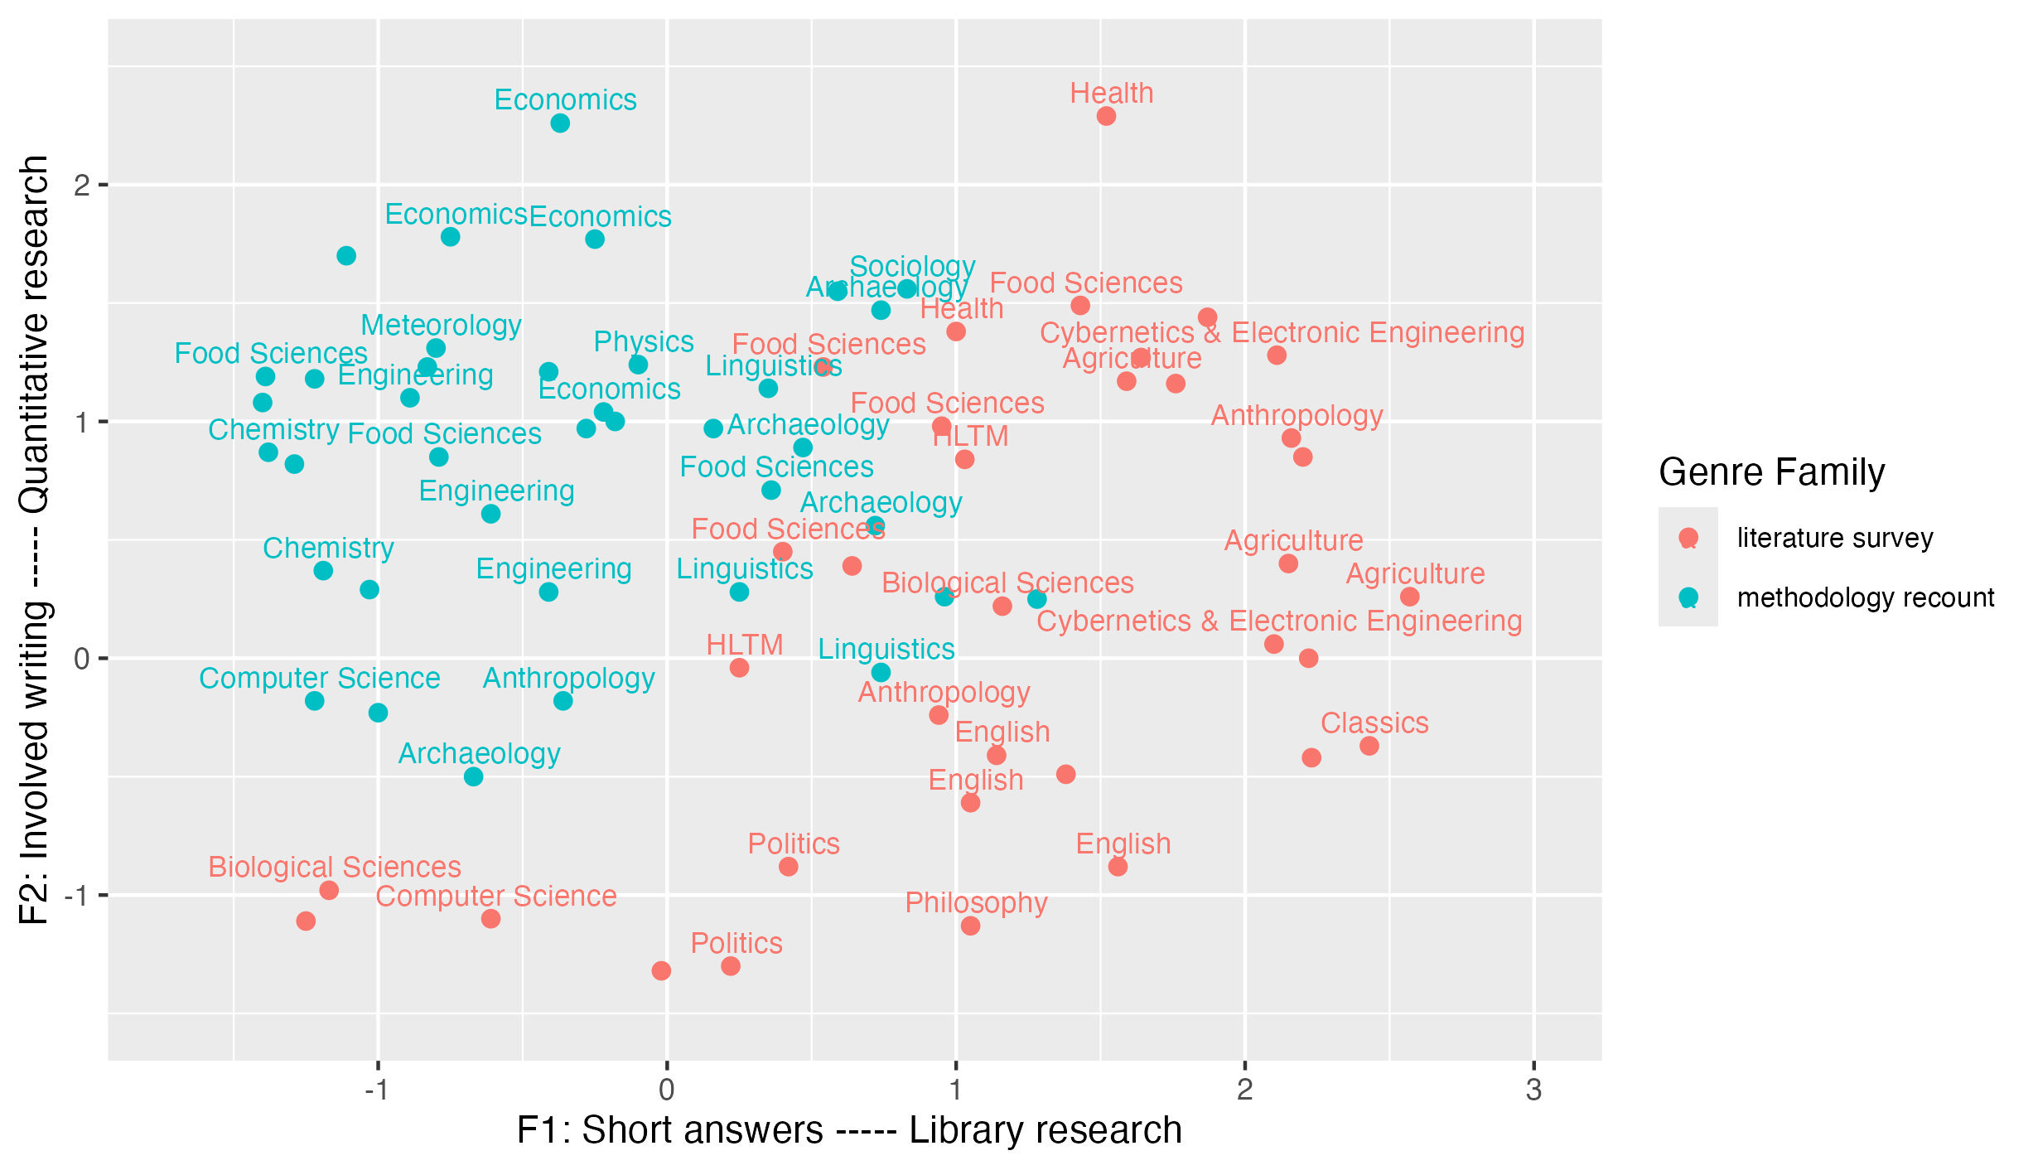

Slide 54
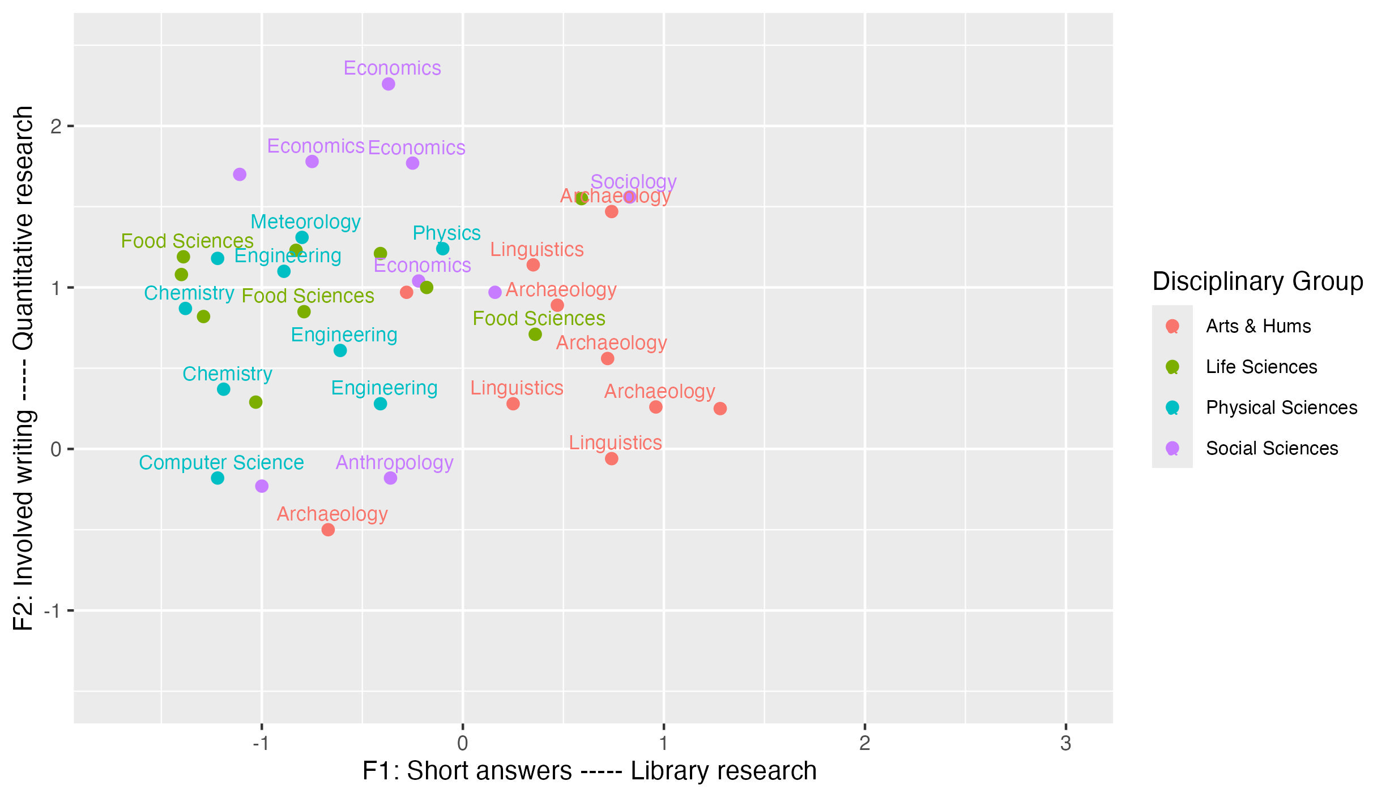

Slide 55
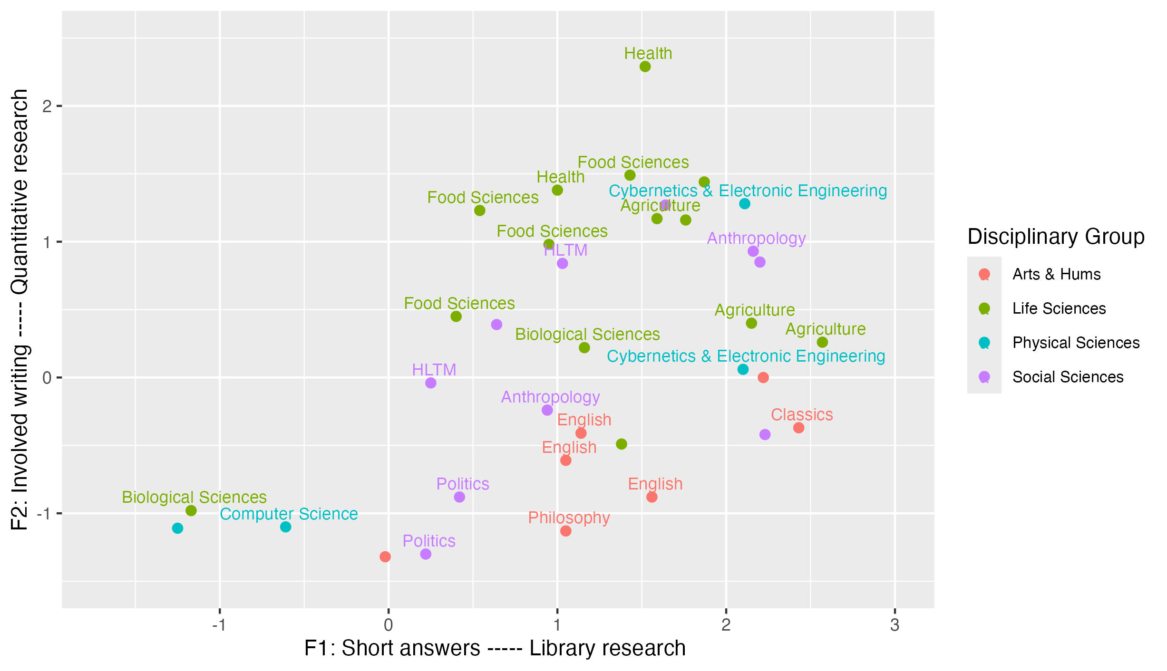

Slide 57
Milk Proteins
Cow's milk contains about 87% water. The remainder consists of fat (4%), proteins (3.5%), lactose (4.8%) and small quantities of inorganic salts. Basically, milk contains two main types of protein: casein (80%) and whey proteins (20%). Casein and whey proteins are distinguished by their differing solubility at pH 4.6 (at 20°C), caseins are insoluble, whereas whey proteins are soluble (Clark, 2004).
(Food Sciences, Y3, F1: .54; F2: 1.09)

Slide 59
I suggest that the papers to be reviewed can be sorted into three sections; morphology, evolution and applications. This has been done because the articles appear to approach the subject of the genetic control of plant morphology from these three different angles.
MORPHOLOGY
In this section, three papers which investigate the specific effects of genes on morphology in chronological order are first reviewed, (Harevenal. 1996, Kimal. 1999 and Petschal. 2005). The more general report overviews of the genetic control of flowering time was then reviewed to conclude the section.
(Biological Sciences, M-level, F1: 1.38; F2: -.49)

Slide 60
Conclusions

Slide 61
Text types are heterogeneous and overlapping.
“culturally-recognized categories that can be described, not scientific categories that can be defined” (Biber & Egbert, 2023: 19)
We can complement categorization by mapping texts in continuous multidimensional space.
This highlights similarities and differences across categories.
And shows key principles underlying variation.

Slide 62
Developing this…
Continuing to develop parameters
Understanding how teachers / students interpret text types
Mapping texts across educational levels
Correlating text type variation to features of language…
…across subject areas / educational levels

Slide 63
Thank you!
p.l.durrant@exeter.ac.uk
@phil-durrant.bsky.social

Slide 64
References
Biber, D. & Egbert, J. 2023. What is a register? Accounting for linguistic and situational variation within–and outside of–textual varieties. Register Studies 5(1). 1–22.
Biber, D., Egbert, J., & Keller, D. (2020). Reconceptualizing register in a continuous situational space. Corpus linguistics and linguistic theory, 16(3), 581-616.
Biber, D., Johansson, S., Leech, G., Conrad, S., & Finegan, E. (2021). Grammar of spoken and written English. Amsterdam: John Benjamins Publishing Company.
Britton, J., Burgess, T., Martin, N., & Rosen, H. (1975). The development of writing abilities 11-18: Macmillan.
Coffin, C. (2006). Historical Discourse: The Language of Time, Cause and Evaluation. London: Continuum.
Durrant, P. (2022). Studying children’s writing development with a corpus. Applied Corpus Linguistics.
Durrant, P., & Brenchley, M. (2023). Development of noun phrase complexity across genres in children’s writing. Applied Linguistics, 44(2), 239 - 264.
Durrant, P., Brenchley, M., & Clarkson, R. (2020). Syntactic development across genres in children's writing: The case of adverbial clauses. Journal of Writing Research, 12(2), 419-452.
Durrant, P., Brenchley, M., & McCallum, L. (2021). Understanding development and proficiency in writing: quantitative corpus linguistic approaches. Cambridge: Cambridge University Press.
Rivera, C. (2007). Foreward. In A. L. Bailey (Ed.), The Language Demands of School: Putting academic English to the test. New Haven & London: Yale University Press.
Römer, U., & O’Donnell, M. B. (2011). From student hard drive to web corpus (part 1): the design, compilation and genre classification of the Michigan Corpus of Upper-level Student Papers (MICUSP). Corpora, 6(2), 159-177.

Slide 65
Extras…

Slide 66
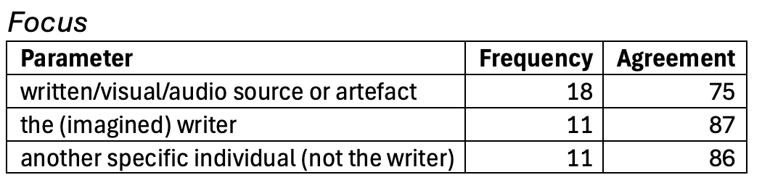
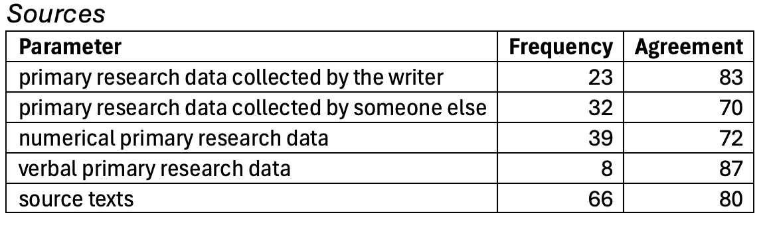
Evaluating codes
Frequency = % texts in which feature occurs
Agreement = % identical codes

Slide 67
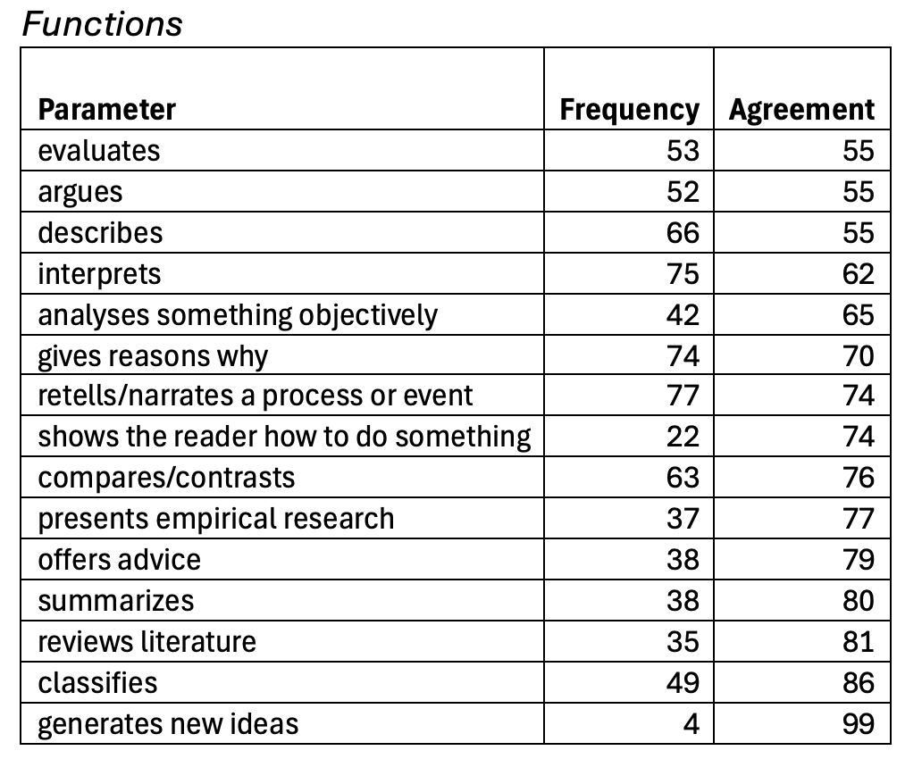
Evaluating codes
Frequency = % texts in which feature occurs
Agreement = % cases within one band

Slide 68
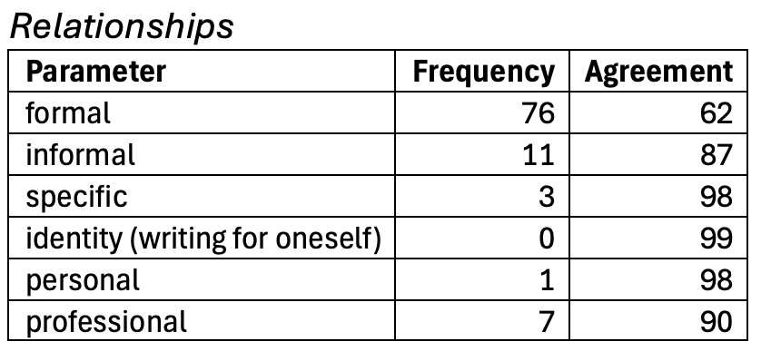
Evaluating codes
Frequency = % texts in which feature occurs
Agreement = % identical codes

