Slide 1
Text types and disciplinary literacy
Phil Durrant

Slide 2

Should we go to bed at 7.30.??
We have been discussing whether children should go to bed at 7.30.
Many people believe that children should go to bed at 7.30 because firstly when you are rly erly wied erwack you will not be sleepy.
Secndly orso you will be at school erly in time.
Lastly when you eriv you will have a big smily on face and your tetcher will not shalt at you.
In conclooshen ther are lotes ov resens for and agnst gowing to bed at 7.30 because fristly some people think

Slide 3
Should we go to bed at 7.30.??
We have been discussing whether children should go to bed at 7.30.
Many people believe that children should go to bed at 7.30 because firstly when you are rly erly wied erwack you will not be sleepy.
Secndly orso you will be at school erly in time.
Lastly when you eriv you will have a big smily on face and your tetcher will not shalt at you.
In conclooshen ther are lotes ov resens for and agnst gowing to bed at 7.30 because fristly some people think

Slide 4
Should we go to bed at 7.30.??
We have been discussing whether children should go to bed at 7.30.
Many people believe that children should go to bed at 7.30 because firstly when you are rly erly wied erwack you will not be sleepy.
Secndly orso you will be at school erly in time.
Lastly when you eriv you will have a big smily on face and your tetcher will not shalt at you.
In conclooshen ther are lotes ov resens for and agnst gowing to bed at 7.30 because fristly some people think

Slide 5
Should we go to bed at 7.30.??
We have been discussing whether children should go to bed at 7.30.
Many people believe that children should go to bed at 7.30 because firstly when you are rly erly wied erwack you will not be sleepy.
Secndly orso you will be at school erly in time.
Lastly when you eriv you will have a big smily on face and your tetcher will not shalt at you.
In conclooshen ther are lotes ov resens for and agnst gowing to bed at 7.30 because fristly some people think

Slide 6
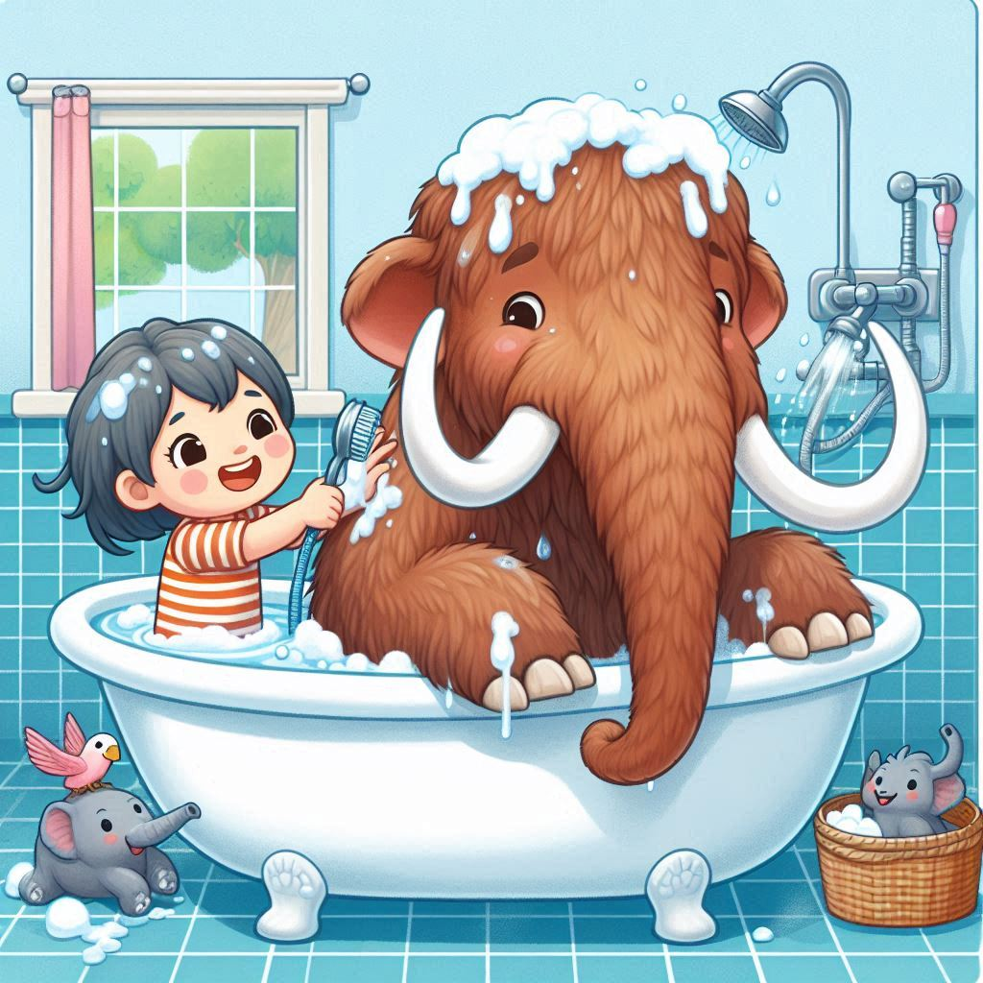
Pour in the bath tub generously because the shiny tap is boiling hot.
Next quickly add bubbles before your furry mammoth gets overexited.
After that get your woolly mammoth into the unbakuble bath.
Then begin to srub your tickilish mammoth until he's clean.
Make a big splash so you lorg mammoth has a lot of FUN!
after wash his hair and dont foget to wash is hair.
Don't fuget to wash his give fat tummy and his ears. and try not to get any in his eyes
After throw in the towl and snuggle up.

Slide 7
Pour in the bath tub generously because the shiny tap is boiling hot.
Next quickly add bubbles before your furry mammoth gets overexited.
After that get your woolly mammoth into the unbakuble bath.
Then begin to srub your tickilish mammoth until he's clean.
Make a big splash so you lorg mammoth has a lot of FUN!
after wash his hair and dont foget to wash is hair.
Don't fuget to wash his give fat tummy and his ears. and try not to get any in his eyes
After throw in the towl and snuggle up.

Slide 8
Pour in the bath tub generously because the shiny tap is boiling hot.
Next quickly add bubbles before your furry mammoth gets overexited.
After that get your woolly mammoth into the unbakuble bath.
Then begin to srub your tickilish mammoth until he's clean.
Make a big splash so you lorg mammoth has a lot of FUN!
after wash his hair and dont foget to wash is hair.
Don't fuget to wash his give fat tummy and his ears. and try not to get any in his eyes
After throw in the towl and snuggle up.

Slide 9
Educators need to understand how…
specific task types pose specific language challenges
and offer specific learning opportunities
how task types overlap/differ across year groups / disciplines

Slide 10
Also…
Models of academic language and language development need to incorporate task type variation.

Slide 11
But…
there appears to be little consensus on what counts as central types of student writing or on how listed categories (e.g., ‘report’ or ‘argumentative essay’) ought to be defined.
Römer & O’Donnell (2011)
It seems that the registers that exist in university writing change with each new study
Goulart (2024)

Slide 12
For example: expository writing
the child was asked to assume the role of a … nonfiction book scientist-writer and compose … an information report on a familiar topic (Fang, 2002)
Pretend you are a super hero and you are being interviewed on the news. Tell everyone what special powers you would have. Also, explain what you would do with them to help the world (Hall-Mills & Apel, 2015)
Imagine that there is a large undeveloped space in your school yard. Every student in the school has been asked for ideas about what to put there. A committee of teachers and parents will choose the best suggestion (Roessingh, Elgie, & Kover, 2015)
I like (person, place, or thing)______ because _______ (Yates, Berninger, & Abbott, 1995)

Slide 13
Why is this so hard to get right?
Text types are dynamic and internally diverse
Many real texts don’t belong to a single category
Transgressing boundaries/hybridisation can be a marker of maturity (e.g., Bazerman et al., 2018; Berman & Verhoeven, 2002)
Classification requires complex interpretation

Slide 14
A way forward: non-categorical text types
“We classify at out peril” (Britton et al. 1975, p.1)

Slide 15
We see [text] categories not as a set of pigeon holes into one of which any piece of writing can be deposited, but rather as multidimensional, that is a piece of writing can be located at different places on a set of axes
(Britton et al. 1975, p.12)

Slide 16
The topological approach…takes into account overlaps and similarities and locates items on gradients of similarity along various functional parameters. Rather than imposing boundaries of difference, such an approach maps degrees of similarity. It models choice in terms of tendencies and degrees rather than with with dichotomous (either/or) terms available within a typological system network
(Coffin, 2006, p.46)

Slide 17
Implementing this
(inspired by Biber et al. 2020)

Slide 18
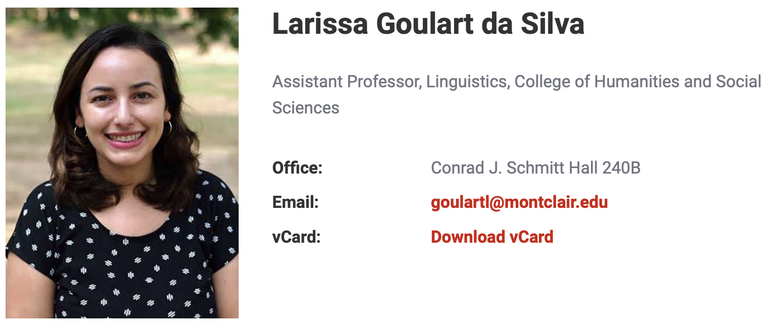




Slide 19
Step 1: define possible distinctive features

Slide 20
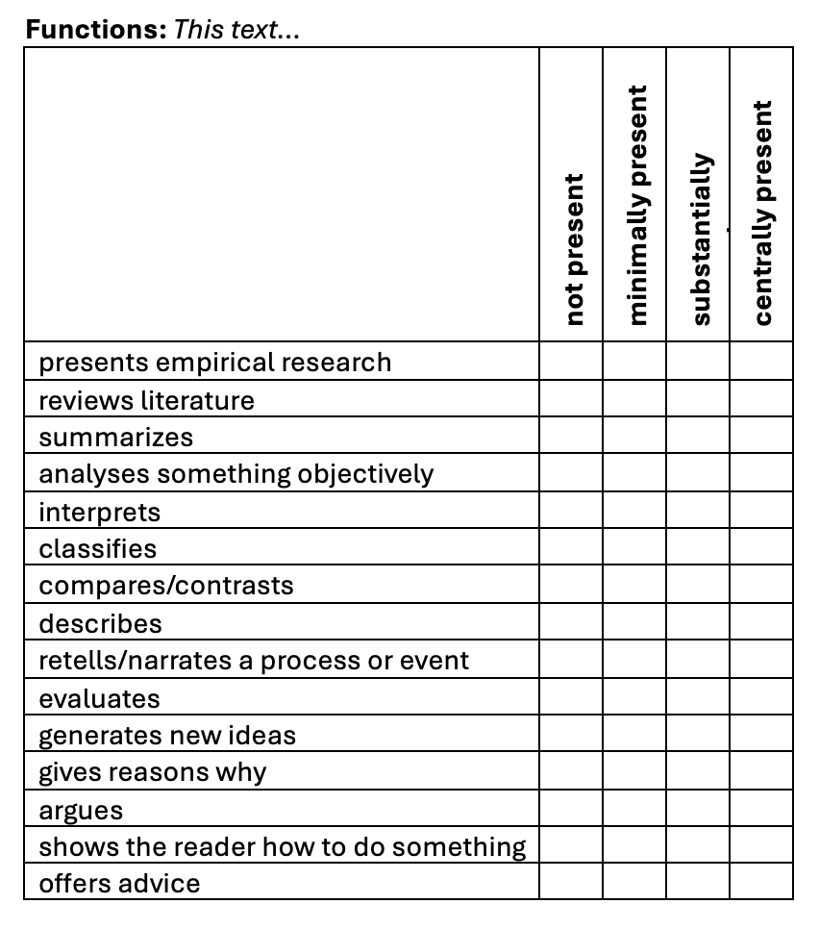
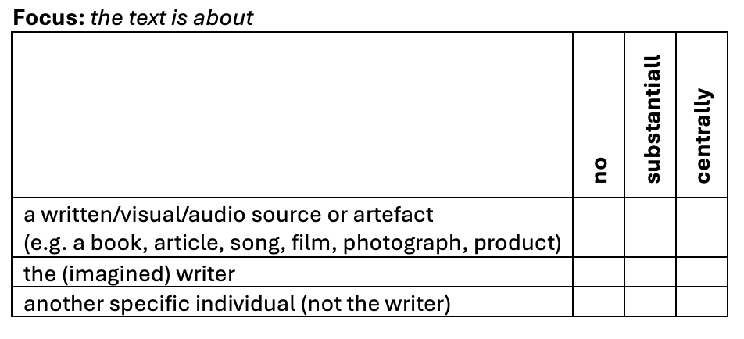
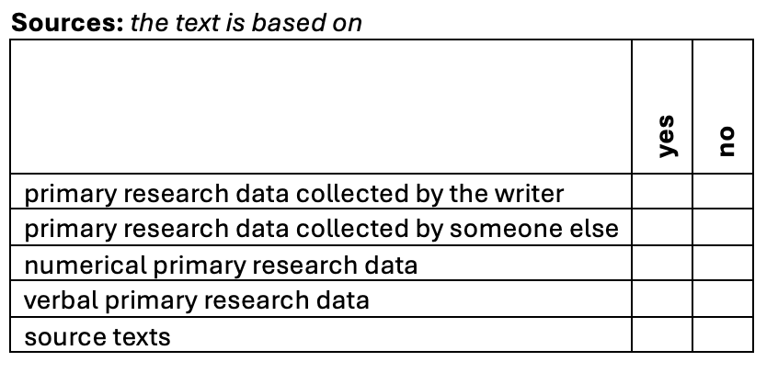
Step 1: define possible distinctive features

Slide 21
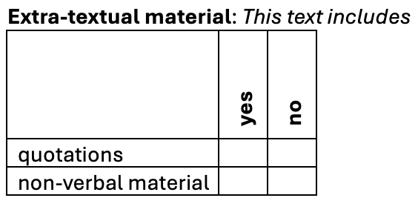
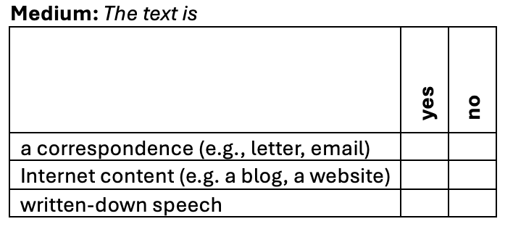
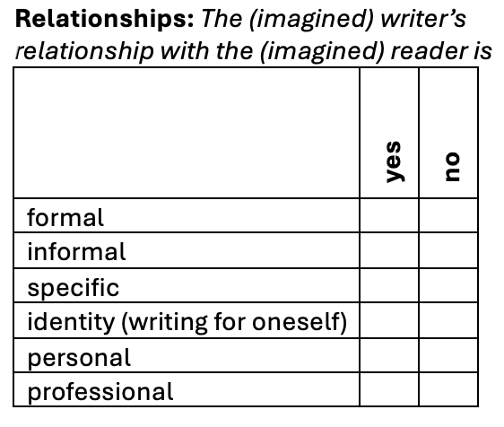
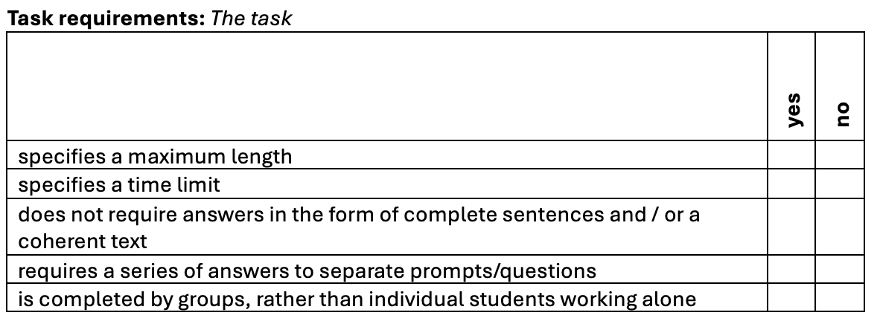

Slide 22
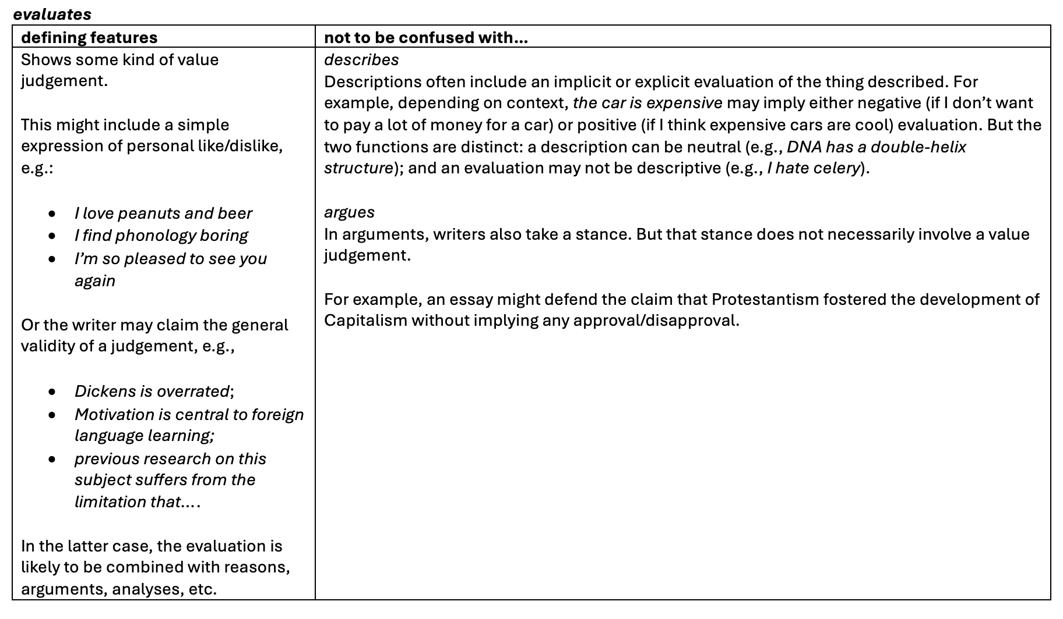

Slide 23
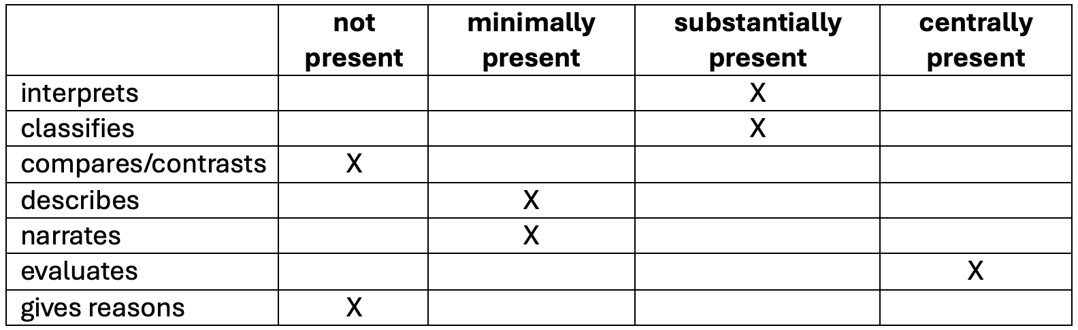
Step 2: Rate texts on each feature

Slide 24
Texts sampled from BAWE corpus
 | Arts & Hums | Life Sciences | Physical Sciences | Social Sciences | Total
case study | 0 | 12 | 12 | 12 | 36
critique | 9 | 9 | 9 | 9 | 36
design specification | 0 | 0 | 36 | 0 | 36
empathy writing | 1 | 19 | 9 | 3 | 32
essay | 9 | 9 | 9 | 9 | 36
exercise | 9 | 9 | 9 | 9 | 36
explanation | 9 | 9 | 9 | 9 | 36
literature survey | 7 | 14 | 4 | 10 | 35
methodology recount | 9 | 9 | 9 | 9 | 36
narrative recount | 8 | 9 | 9 | 9 | 35
problem question | 0 | 1 | 3 | 32 | 36
proposal | 0 | 12 | 12 | 12 | 36
research report | 9 | 9 | 9 | 9 | 36
Total | 70 | 121 | 139 | 132 | 462

Slide 25
Step 3: Factor analysis
For 20 parameters found in > 5% texts and with > 70% agreement
4 factors explained 38% of variance:
  explicit library research (12%)
  focus on quantitative data vs. focus on individuals (11%)
  reporting a research or design process (9%)
  personal informal writing (6%)

Slide 26
Dimension 1:
Explicit library research
 | structure loading
reviews literature | .78
summarizes | .77
source texts | .71
quotations | .53
primary research data collected by someone else | .36
requires a series of answers to separate prompts questions | -.28
non-verbal material | -.30
(12% of total variance)

Slide 27
For example…
Herodotus and Egypt
The sheer bulk of material written about Herodotus and Egypt has, unsurprisingly, constrained me to focus upon a particularly narrow aspect of Herodotean scholarship, namely the veracity of his historical methods and his relationship with his predecessor Hecataeus. I have intended to produce a broad sweep of the most important literature on this topic over time from the late nineteenth century to the present.
(Classics, M-level: D1=2.43)

Slide 28
For example…
E.J. Clery, Women's Gothic: From Clara Reeve to Mary Shelley, 2nd edn (Devon: Northcote, 2004)
Explains the rise of Gothic fiction through its socio-historical context. Studies the work of the main Gothic female writers. States the most thrusting and assertive female writers were the Gothic novelists. Stresses the importance of passion and extreme feelings in the Gothic which are presented through its extraordinary plots.
(English, M-level. D1 = 2.22)

Slide 29
Factor 2:
Quantitative research
vs.
Involved writing
 | structure loading
numerical primary research data | 0.78
presents empirical research | 0.54
primary research data collected by someone else | 0.52
non-verbal material | 0.52
compares / contrasts | 0.36
primary research data collected by the writer | 0.32
informal | -0.30
focus on the imagined writer | -0.31
focus on another specific individual (not the writer) | -0.36
(11% of total variance)

Slide 30
For example
“a cross sectional data analysis for 40 low to middle income countries” analysing the effects of manufacturing on GDP growth and “what elements determine manufacturing exports and thus what implications these might have on policy making”
(Economics, Y1, D1: 2.16)

Slide 31
For example…
Dear Jane
I enclose a sample chapter of my book Angel of the Night. My book is aimed mainly at women aged 20 and above. Detective Adam Belmayne is recovering from a recent divorce and decides to throw himself into his work. The latest case is…
(English, Y1, D2 = -1.87)

Slide 32
focus on quantitative research
explicit library research
focus on individuals

Slide 33
Characterising genres
Building research skills: Literature Surveys & Methodology Recounts

Slide 34
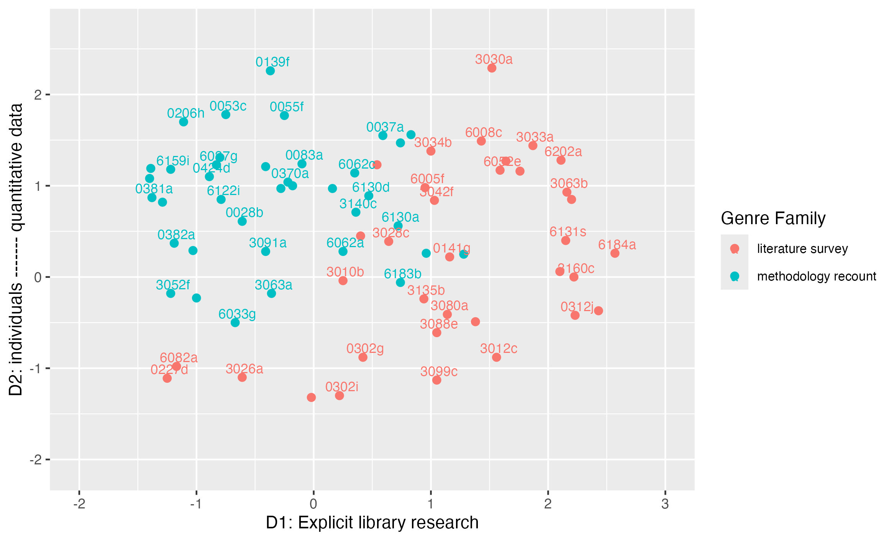

Slide 36
This essay describes some selected studies using comparative microbial genomics. Two investigations are discussed in detail, namely those on Enterococcus faecalis and Bacillus anthracis.
(Biological Sciences, Y2)

Slide 38
Volkswagen Beetle
The Volkswagen beetle the VW type 1 is a small family car. It's the most popular car among the Volkswagen family, also its one of the famous cars from Germany. It has its own unique design which makes it recognizable among a million of other cars. The production went from 1938 until year 2003 it was only interrupted by the World War II. Over 21 million were produced at the end of 2003…
The Coca-Cola bottle
A very popular beverage known by every one by its nick name coke is a carbonated soft drink produced by the Coca Cola company in Atlanta It was invented in the late 19 th century as a patent medicine which was sold for five cents a glass…
(Engineering, Y1)

Slide 40
…'How does the use of superlative adjectives differ between the broadsheet newspaper The Guardian and the tabloid newspaper The Mirror…
The first stage of the method was the collection of the data, which was achieved by locating the two suitable websites. The articles applicable to the recent events surrounding Charles Kennedy were then viewed as a printable version and saved as a text file. A word count was then performed on each of the corpuses to establish the total number of words in each.
(Linguistics, Y2)

Slide 42
Description of Preservation:
The preservation of this skeleton is good. All bones appear to be present, although the sternum is shattered and the long bones are missing their ends with the exception of the radius and the ulna of both arms…
(Archaeology, Y2)

Slide 43
Genres & disciplinarity

Slide 44
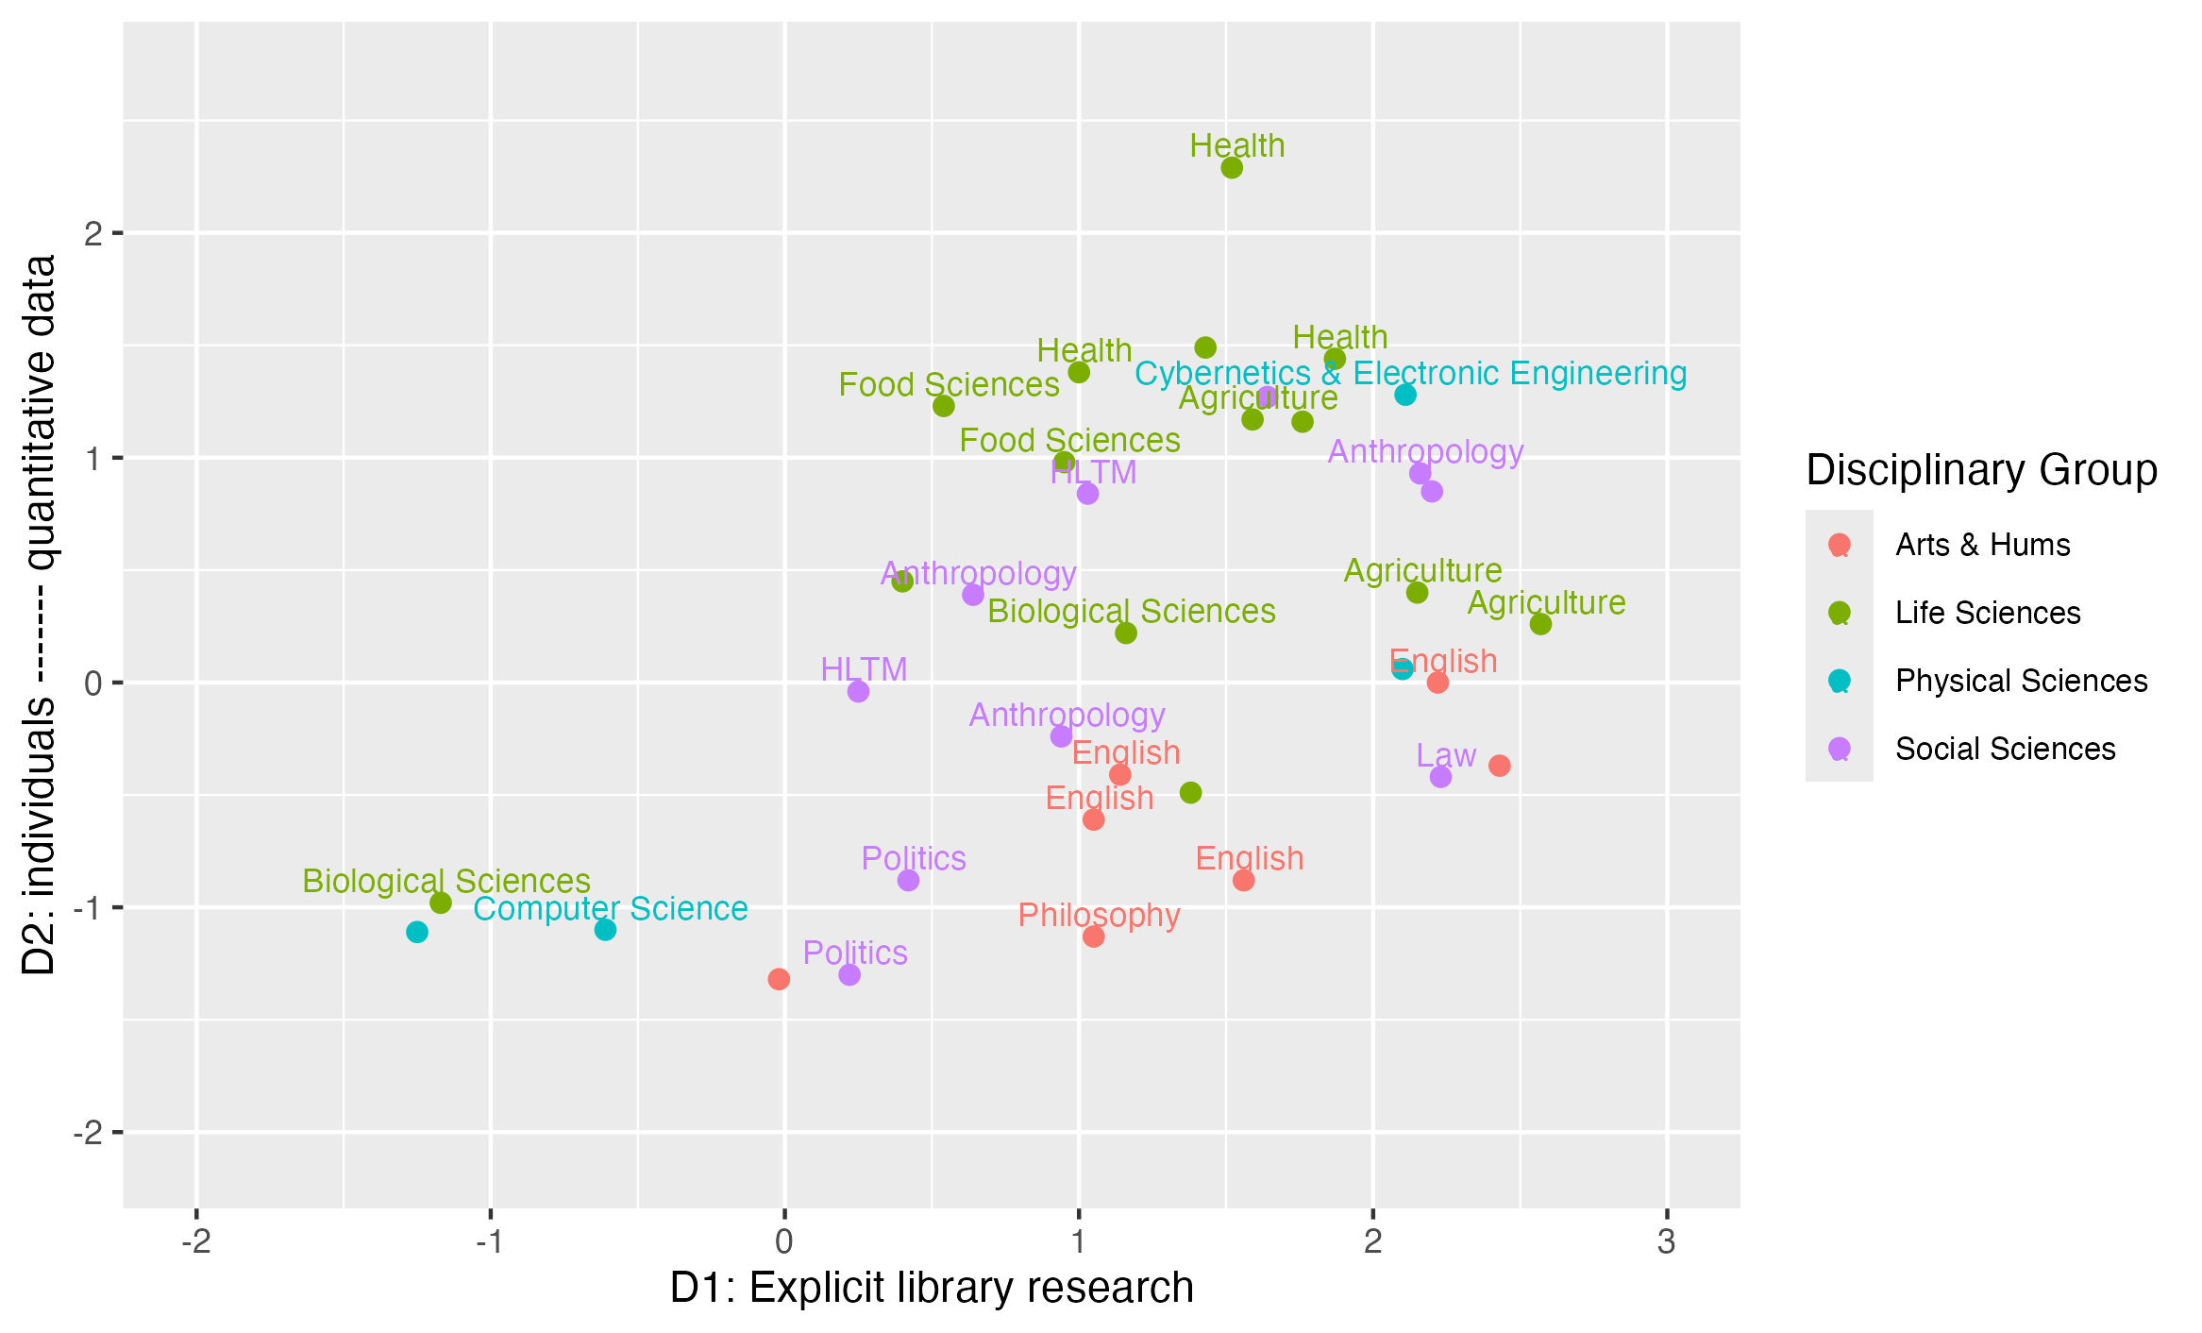

Slide 45
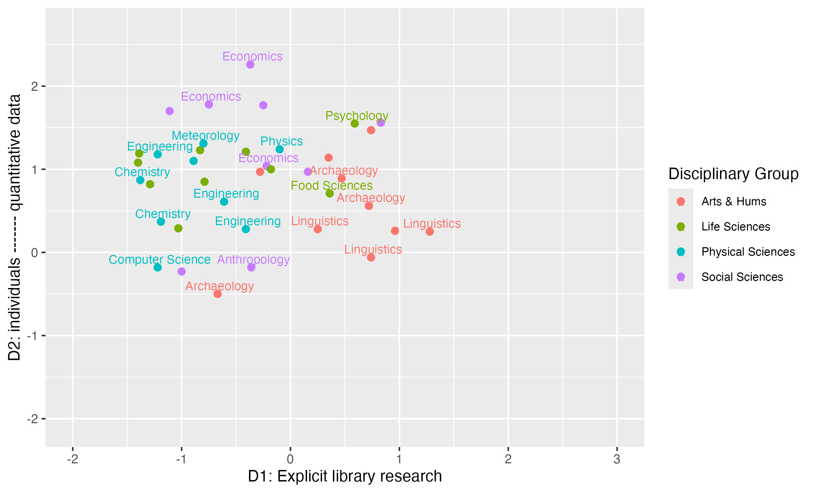

Slide 46
Conclusions

Slide 47
Text types are heterogeneous and overlapping.
“culturally-recognized categories that can be described, not scientific categories that can be defined” (Biber & Egbert, 2023: 19)
We can complement categorization by mapping texts in continuous multidimensional space.
This highlights similarities and differences across categories.
And shows key principles underlying variation.

Slide 48
Developing this…
Continuing to develop parameters
Understanding how teachers / students interpret text types
Mapping texts across educational levels
Correlating text type variation to features of language…
…across subject areas / educational levels

Slide 49
Thank you!
p.l.durrant@exeter.ac.uk
@phil-durrant.bsky.social

Slide 50
References
Biber, D. & Egbert, J. 2023. What is a register? Accounting for linguistic and situational variation within–and outside of–textual varieties. Register Studies 5(1). 1–22.
Biber, D., Egbert, J., & Keller, D. (2020). Reconceptualizing register in a continuous situational space. Corpus linguistics and linguistic theory, 16(3), 581-616.
Biber, D., Johansson, S., Leech, G., Conrad, S., & Finegan, E. (2021). Grammar of spoken and written English. Amsterdam: John Benjamins Publishing Company.
Britton, J., Burgess, T., Martin, N., & Rosen, H. (1975). The development of writing abilities 11-18: Macmillan.
Coffin, C. (2006). Historical Discourse: The Language of Time, Cause and Evaluation. London: Continuum.
Durrant, P. (2022). Studying children’s writing development with a corpus. Applied Corpus Linguistics.
Durrant, P., & Brenchley, M. (2023). Development of noun phrase complexity across genres in children’s writing. Applied Linguistics, 44(2), 239 - 264.
Durrant, P., Brenchley, M., & Clarkson, R. (2020). Syntactic development across genres in children's writing: The case of adverbial clauses. Journal of Writing Research, 12(2), 419-452.
Durrant, P., Brenchley, M., & McCallum, L. (2021). Understanding development and proficiency in writing: quantitative corpus linguistic approaches. Cambridge: Cambridge University Press.
Rivera, C. (2007). Foreward. In A. L. Bailey (Ed.), The Language Demands of School: Putting academic English to the test. New Haven & London: Yale University Press.
Römer, U., & O’Donnell, M. B. (2011). From student hard drive to web corpus (part 1): the design, compilation and genre classification of the Michigan Corpus of Upper-level Student Papers (MICUSP). Corpora, 6(2), 159-177.

Slide 51
Extras…

Slide 52
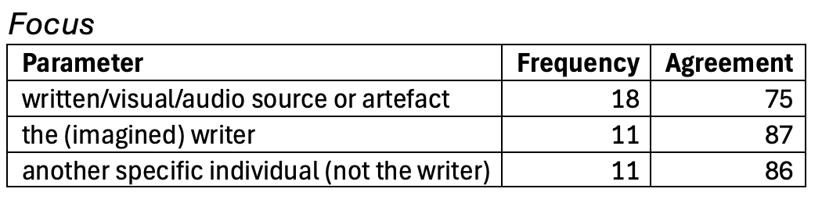
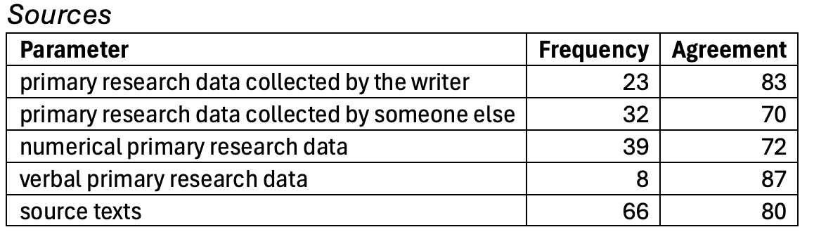
Evaluating codes
Frequency = % texts in which feature occurs
Agreement = % identical codes

Slide 53
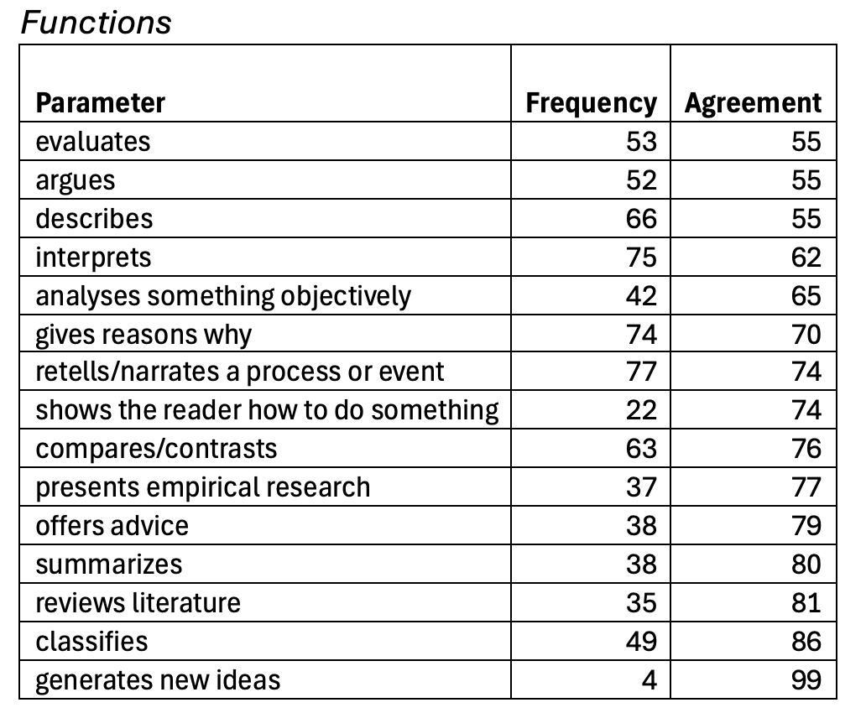
Evaluating codes
Frequency = % texts in which feature occurs
Agreement = % cases within one band

Slide 54
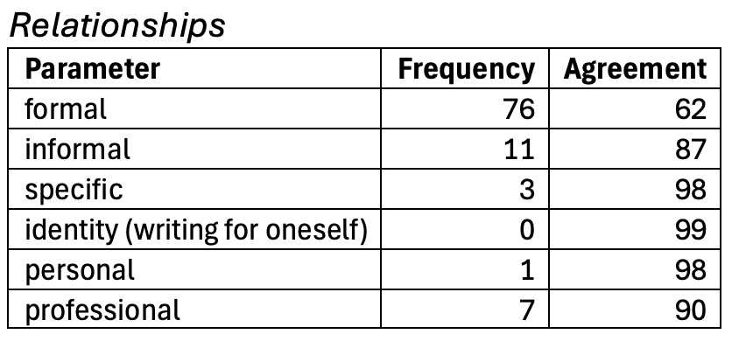
Evaluating codes
Frequency = % texts in which feature occurs
Agreement = % identical codes

